Slide 1
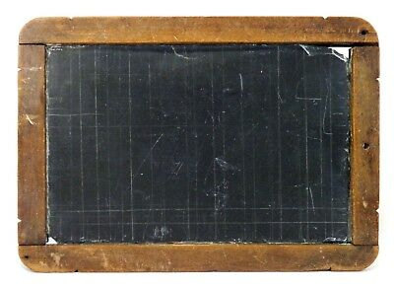
Kirikiriroa Rāwhiti te Kura
Hamilton East School 2022

Slide 2
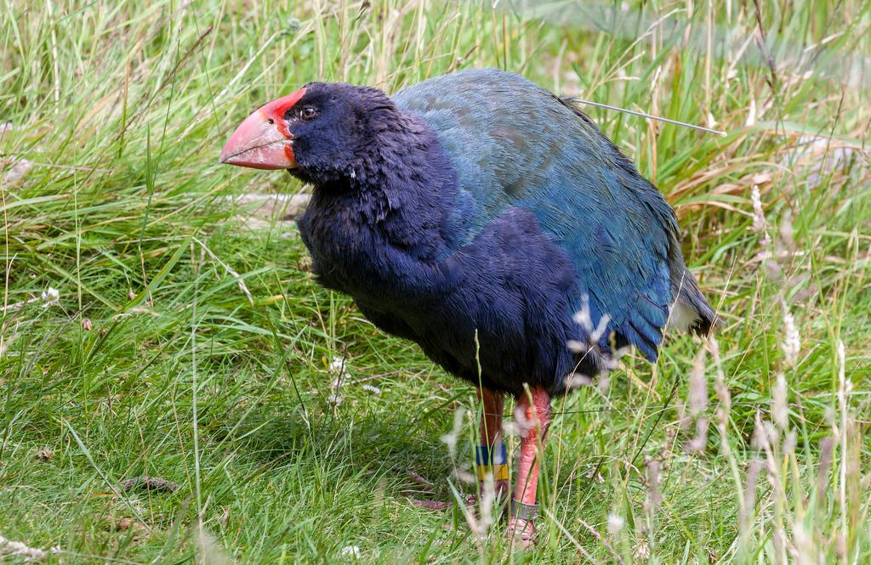
Karakia o te Takahē
We must learn
As if we are takahē
With its ability to communicate
A regal bird
From the great forest of Tane
Through its example
to us
We will continue to flourish
For all time
This is the essence of life!
Me akō mātou
Anō nei he takahē
Kia whaka whitiwhiti
kōrero ai
He manu rangatira
O te wao nui a Tane.
Nā tana tauiratanga
Kia kaha tonu ai mātou
ki te tipu ake
Mō ake tonu atu
Tihei mauri ora
Flightless. Chatty bird with other takahe.
The bird who came back from the dead. Was rediscovered in Fiordland.
Had a north island cousin, the now extinct larger, Moho.
A regal bird, crowned with a large red beak.
Sharp scissor like beak - great for eating the soft shoot parts of grasses.
‹#›

Slide 3
I nga wa o mua
THEN and NOW
Totara Team - Takahe Hub
Room 19 and Whaea Arna researched
developments and changes
over the last 150 years.
Thank you to Doreen, Sue,
and Cathy for your support.

Slide 4
School 150 years ago
By Andie
150 years ago, when my school first opened, school was very different back then. There was only one classroom at our school and it is still used as an actual classroom. They didn’t have any shoes or heaters so in winter they got very cold. At playtime (because they didn’t have any toys) they had to use their imagination a lot. It was also different in other ways, like they had hand held bells and the teachers smacked the students on their hands for punishment. Now I could go on with this but it would take too long so I’ll stop here. I think if I was a student then I would be very scared if I was about to get smacked.
Notes:
School 150 years ago
By Andie
150 years ago, when my school first opened, school was very different back then. There was only one classroom at our school and it is still used as an actual classroom. They didn’t have any shoes
or heaters so in winter they got very cold. At playtime (because they didn’t have any toys) they had to use their imagination a lot. It was also different in other ways, like they had hand held bells and the teachers smacked the studentson their hands for punishment. Now I could go on with this but it would take to long so i’ll stop here. I think if I was a studnet then I would be very scared if I was about to get smacked.

Slide 5
Hamilton East School 150 Years Ago
By Karlton
150 years ago Hamilton East School was fun and boring sometimes. The children did not have a lot of things to do, they could play tag and they could play running games. If they were bad they got hit by a stick on the hand. They did not have electricity or any devices. If I was alive I would feel bad and good.

Slide 6
School in 1872
By Noah
As l woke l saw people riding horses and doing chores. I heard my mum
shouting from the living room, “Get up! Breakfast is ready!” “Ok!” I said tiredly.
“Man I hate living in 1872.” l got dressed and rode my horse to school. I felt happy, sad, and worried. I saw lots of birds, trees, and bushes.
When l got to the gate my teacher was angry. I walked up to the gate, my feet as cold ice. When I got there my teacher shouted at me “You're late for class.” “Sorry” I said. “After school you will have your punishment.” “Ok” I said sadly.

Slide 7
School in 1872
By Bede
If I went to school in 1872
I would climb tall trees.
I would skip.
I would definitely
not be naughty or I would
get hit by a big stick
across the hand. Slap!
Or a big strap.
That would hurt!
I would feel anxious.
School in 1872
By Leila
One hundred and fifty years ago children got strapped on the hand and the bottom. Kids didn’t have toys because the kids were in the 1800’s. The kids had cold freezing feet on the floor. The kids ran like cheetahs.

Slide 8
School in 1872 (150 Years ago)
By Trisha
Back 150 years ago at HES (it stands for Hamilton East School), people were poor, and our school didn’t have the things we have now. They didn’t have toys, whiteboards, laptops, iPads, computers, and art stuff. They didn’t have a playground either. It really wasn’t fun. But if I was there I would be as cold as ice because it’s cold there! In the past, they wouldn’t be happy, excited, or even thinking about unicorns. So I wouldn’t want to go there, and I wasn’t even born then. So that’s what happened.

Slide 9
In the Olden Days
By Alyssa
In the olden days, the kids used chalkboards to write and draw. Then on their way to school they rode horses. If I was them I would be sad and my feet would be cold on the ground. I would feel cold and the ground would feel like ice. If the kids were naughty then they would get hurt by a stick, ruler, or belt. For their games, they would skip, or go down a slide made out of wood. Some parents kept their kids home to help them do the chores. The kids would play outside, they didn't have lots of toys or a pool to swim in.

Slide 10
School in 1872
By Cohen
If I lived in 1872, I would eat porridge every day because there was no other food. I would climb rough tall trees and also play hopscotch. When I got home I was as slow as a sloth.
I heard my mum. She was furious! She shouted, “You have not eaten your porridge.” “I did that on purpose” I chuckled.
School in 1872
By Xander
150 years ago, the school was brown and made of wood, the uniforms were white. They only had a little bit of toys and only one teacher.

Slide 11
School in 1872 (150 years ago)
By Yasmin
Back in the olden days,we didn’t have nice flashy playgrounds, we also didn’t have plastic bags, which was also fantastic because no plastic means no pollution. So if you were living in the olden days you would think it’s horrible, well it’s not! Here in 2022 it’s horrible because we can’t climb tall spiky trees. What I like about being in school now are the big, exciting playgrounds, iPads, and AirPods. So I think it’s equal, so it’s a tie. I’ll win the next round (if there is a next round). I would not like to eat boring porridge though, like they did in 1872.

Slide 12
School 150 Years Ago
By Maunga
Back in 1872 our school had only one classroom and there was only one teacher! We didn't have many toys and I would have got smacked if I was bad, by a stick or a ruler. Hamilton East School is very old.
School in 1872
(150 years ago)
By Drae
150 years ago at school, there were no
books or pens. There weren't many toys at school in 1872. In 1872 we could only play running games at school. It would be fun, but bad if you got strapped by a teacher.

Slide 13
School In 1872
By Boston
In 1872 I would think the kids in the school would be sad, scared, and sore. First I would think the kids at the school would get strapped if they were doing something bad, silly, or dumb. Also, they didn’t have that many toys and they sometimes used their imagination and played running games. If I went to a school in 1872 I would climb big tall trees and play running games. I would feel excited and scared climbing to the top of the ‘Redwood Tree’.

Slide 14
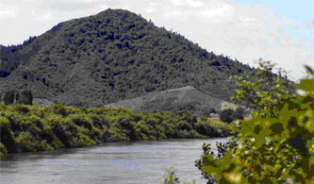
Mihi - Acknowledgement of Our Region
Ko Tainui Te Waka
Ko Taupiri Te Maunga
Ko Waikato Te Awa
Ko Waikato Te Iwi
Ko Pōtatau Te Wherowhero Te Tangata
He Piko, He Taniwha
He Piko, He Taniwha
Waikato Taniwharau
Photo: Waka Kotahi NZ Transport Agency (2021)

Slide 15
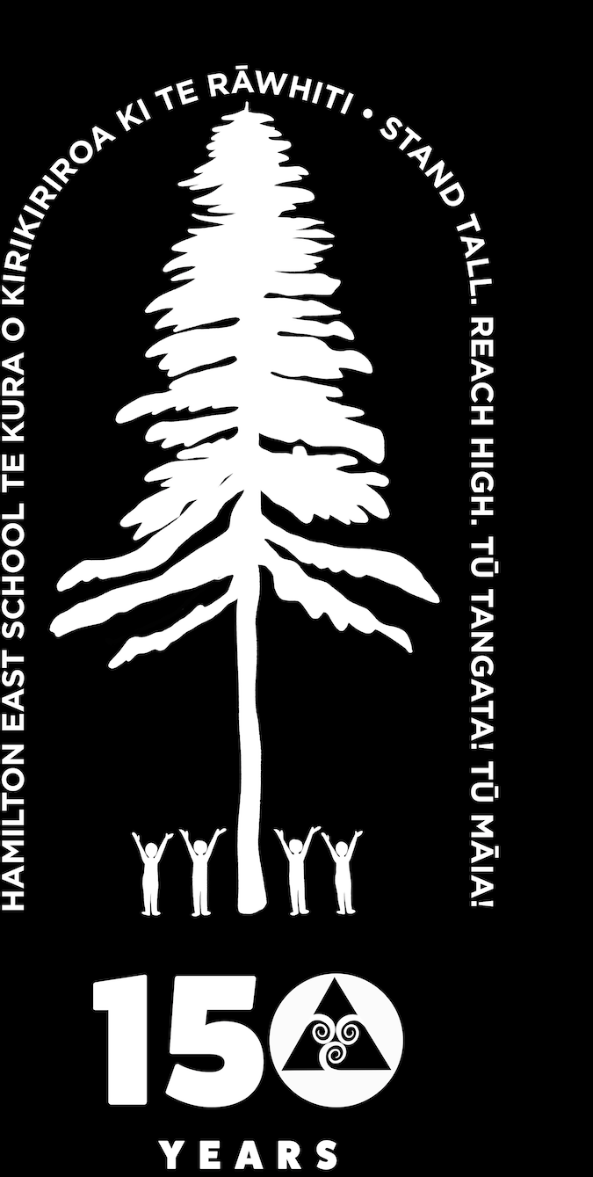
I nga wa o mua
We look to the past to guide
our future
Hamilton East School
150 Years Old!
Established in 1872 (150 Years ago).
Oldest school in Hamilton on original
site since 1876 (146 Years ago).

Slide 16
Hamilton East School Beginning
1872 opened in an old Military government hut
1873 (March) Hamilton East Public Hall
Education Board gave 25 pounds (shillings and pennies) and Hamilton East Community gave 25 pounds.
1876 School closed
1876 Opened on the Corner of Grey and Dawson street
Size: 3 acres 1 rood and eight perches
Cost of Construction 75 Pounds
1876 3 immigrant cottages purchased - one teacher’s room and two classrooms.
Notes:
HES Historical Info https://drive.google.com/drive/u/0/search?q=History

Slide 17
Hamilton East School 2022
Then, students called teachers and staff by Sir, Madam, Mr, Miss, Mrs and their last names.
Now, we call most of our teachers by Matua, Whaea, or their first names.
Then, we had 1 teacher.
Now, we have 45 staff with 36 teachers!
We also have 467 students!

Slide 18
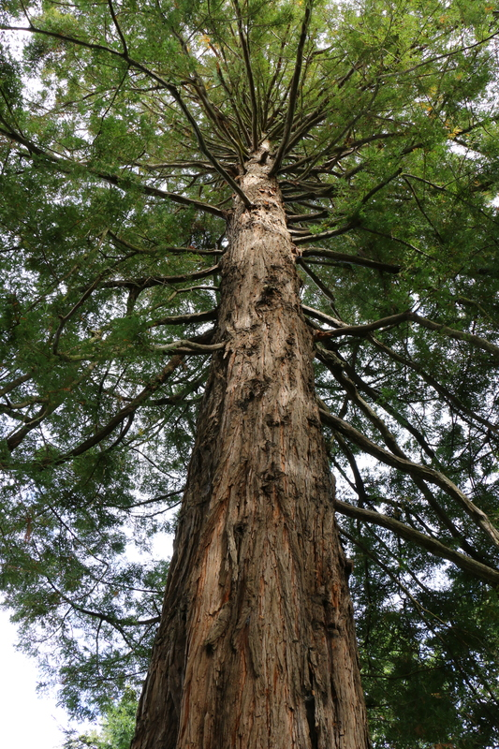
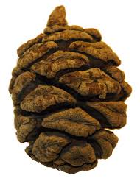
Our Redwood Tree
Our Vision

Slide 19
This whakataukī was recommended by Te Whānau Hononga and endorsed by the Board.
Tū Tangata! Is a call to stand tall and demonstrate ‘personhood’. It encompasses attitudes and values, responsibility and compassion, and standing firm in one’s beliefs. It includes knowing our place in the world, including through acknowledging and valuing whakapapa, reo and tikanga.
Tū Māia! Is a call to demonstrate courage and creativity. It encompasses leadership, independence, confidence and pride and recognition of one’s skills. For Māori, it includes valuing and being Māori.
He kupu akiaki tēnei ki a tātou kia whakanuia te reo Māori, tikanga Māori and mātauranga Māori. This is an opportunity for us to celebrate reo, tikanga and Mātauranga Māori.
‹#›

Slide 20
Room 19 Interviews
By Andie, Samantha, Boston and Eion.
Questions
1. Do you feel proud to go to Hamilton East School and why?
2. What is your favourite thing about Hamilton East School?
3. How do you feel about being a student in Hamilton East School?

Slide 21
Xander
1. I can see my cousin.
2. Playing outside.
3. Excited and happy.
Trisha
1. I like going to Hamilton East School because I make lots of friends.
2. Art and sports.
3. Happy.
Yasmin
1. I am proud to go to Hamilton East School.
2. Science experiments.
3. I feel like my brain is growing.
Noah
1. Because I see my friends.
2. Sketching.
3. I feel good.
Billy
1. Because I see my friends.
2. To play outside.
3. I feel good.
Samantha
1. Because I make friends.
2. Because I make friends.
3. Very proud.

Slide 22
Eion
1. I learn Haka Hiva.
2. Playing outside.
3. I feel good.
Alyssa
1. Playing with my friends.
2. Likes the pool.
3. I feel good.
Cohen
1. I don’t feel proud.
2. Devices.
3. Happy.
Karlton
1. Yes because I like maths.
2. Writing.
3. Good.
Maunga
1. Yes, because I have lots of friends.
2. I like playing with my friends.
3. Happy.
Ruby
1. Because I get to see lots of friends.
2. Reading and maths.
3. Proud and good.

Slide 23
Kiriana
1. I see my friends.
2. Maths.
3. I feel Good.
Sachkirat
1. Making new friends.
2. Math.
3. Good, happy and annoyed.
Ahmed
1. Music on Ipad.
2. Lego.
3. Super happy.
Kanishka
1. Yes. Because I have friends.
2. Doing Math.
3. Amazing.
Harper
1. Yes, because I play with my friends and it is fun.
2. Sketching.
3. Wonderful.
Leila
1. Yes because it is an amazing school.
2. The whole school.
3. Good.

Slide 24
Bede
1. Kind of, because it is the first school I’ve been too.
2. We get more playtime than most other schools.
3. All right.
Jackson
1. Yes, because I have lots of good friends.
2. Playing outside.
3. Happy.
Andie
1. I do feel proud because I have lots of friends.
2. Doing math.
3. Proud.
Drae
1. Yes, I like making friends.
2. Writing.
3. Super happy.

Slide 25
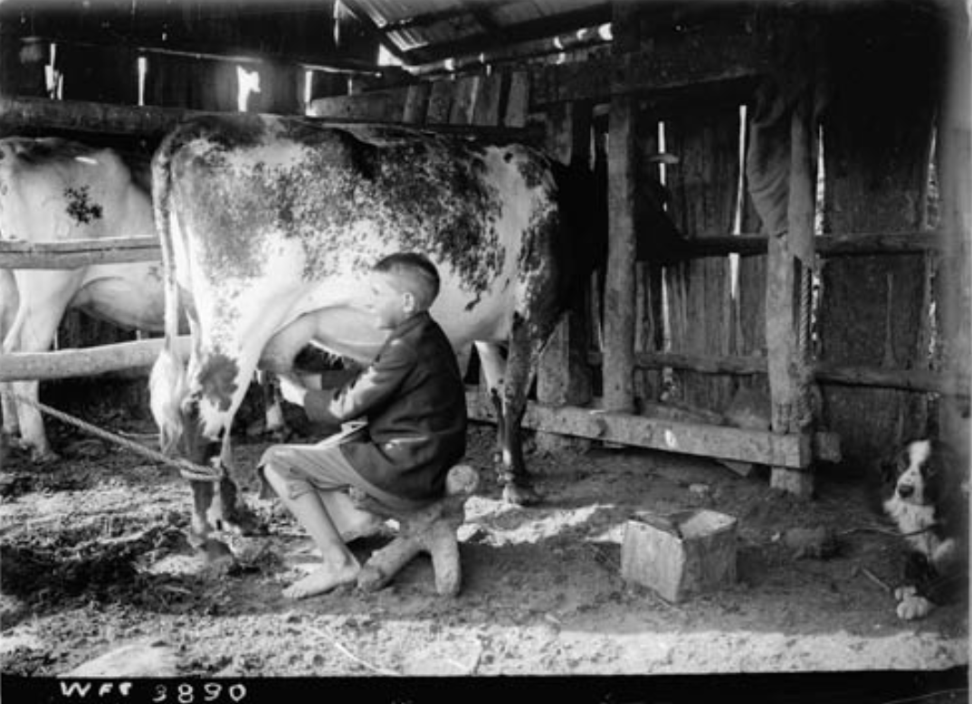
Then, school often came second.
Lots of parents couldn’t make ends meet without children working the family farms, pitching in at family businesses, or getting jobs in mills.
Child milking a cow, 1903 (1st of 3)

Slide 26
Now, school is very important but …
the Covid Pandemic has interrupted our schooling and we have had lots of tamariki and teachers sick or in lockdown. We have had to cancel our Operetta, Art Exhibition, and community and sporting events. We have even had to do our learning and teaching from home.

Slide 27
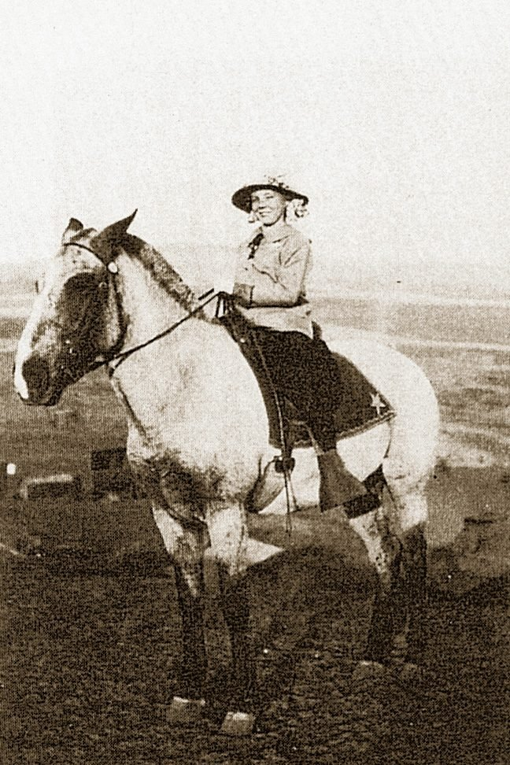
Then, some students had to
travel very far to school
Before there were school buses to take children to school, they walked or rode ponies or horses. Some children rode up to 30 kilometres to get to school. School ponies rarely had just one rider – the whole family would clamber aboard. Ponies waited in a paddock by the school until the end of the day, and then took the children home.
This Is What School Was Like 100 Years Ago
Going to school on horseback

Slide 28
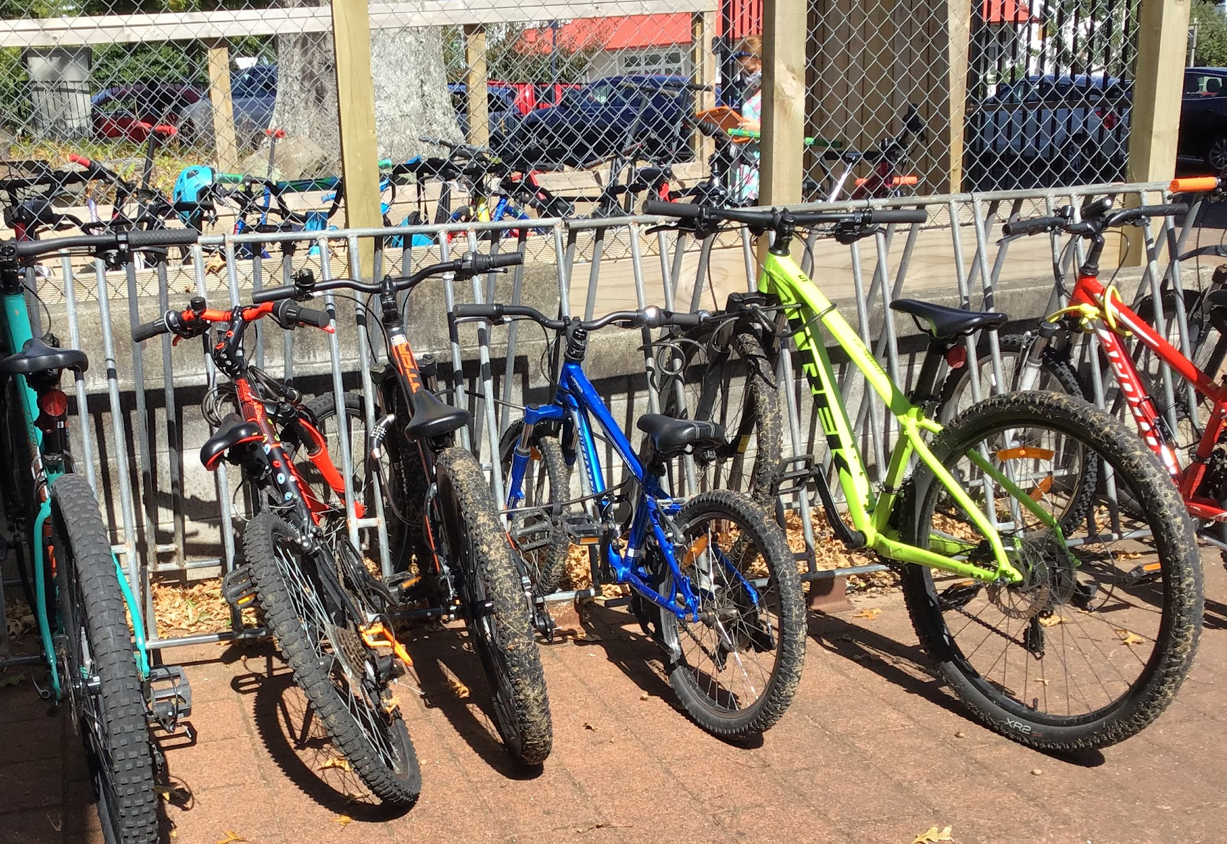
Now, we walk to school or travel to school by bus, cars, scooters, and bikes.
Noah travels from Te Awamutu every day - that’s 27 minutes by car and 29km.
The rest of our class lives in Hamilton East or close by.

Slide 29
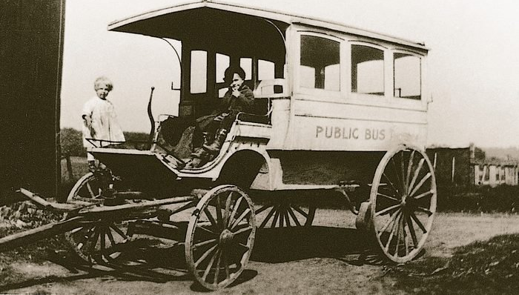
Then, there were no school buses, or they were horse drawn.
This Is What School Was Like 100 Years Ago

Slide 30
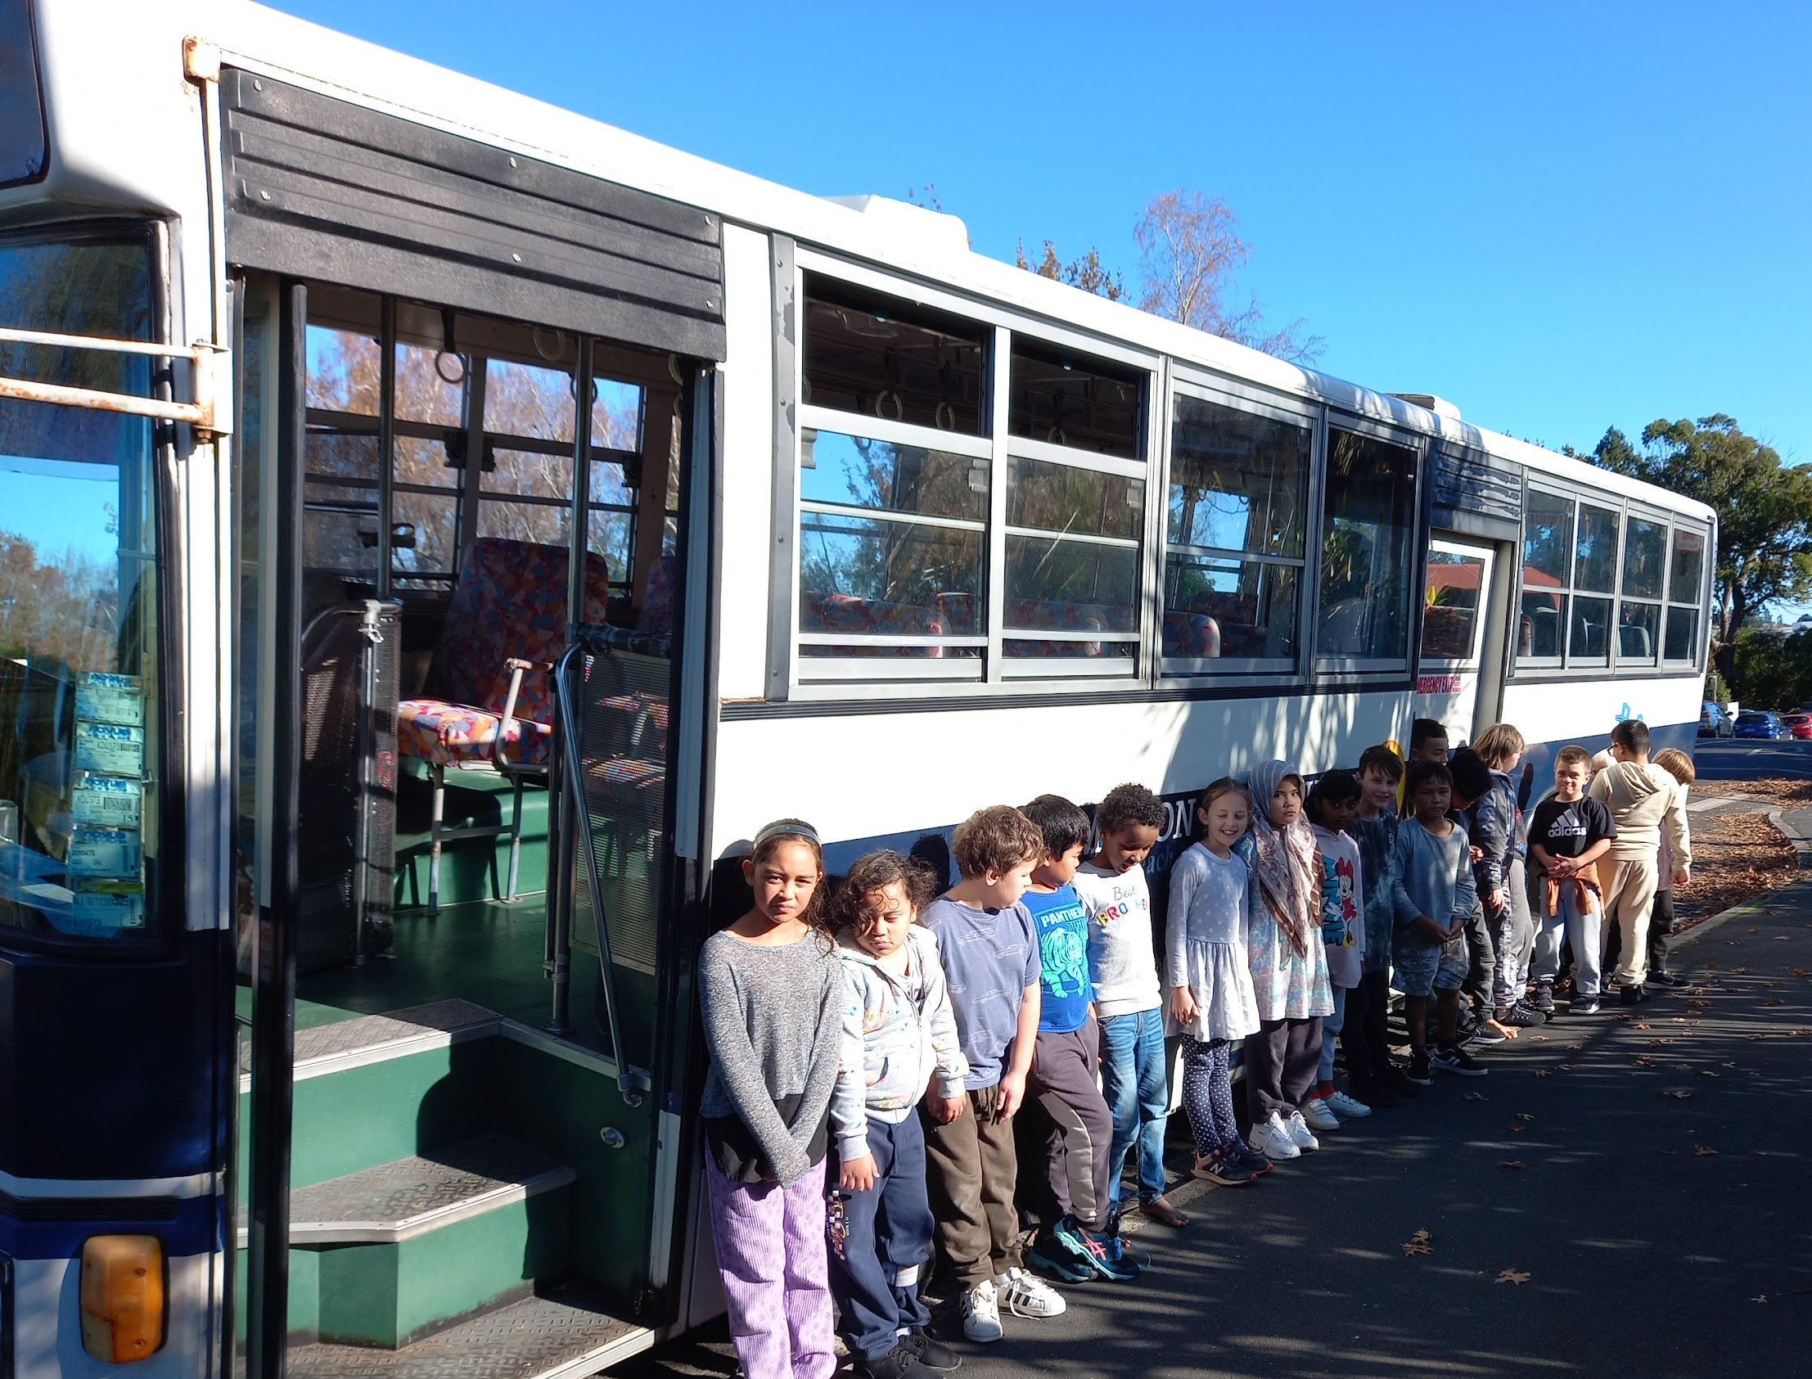
Now, our school bus runs on petrol.

Slide 31
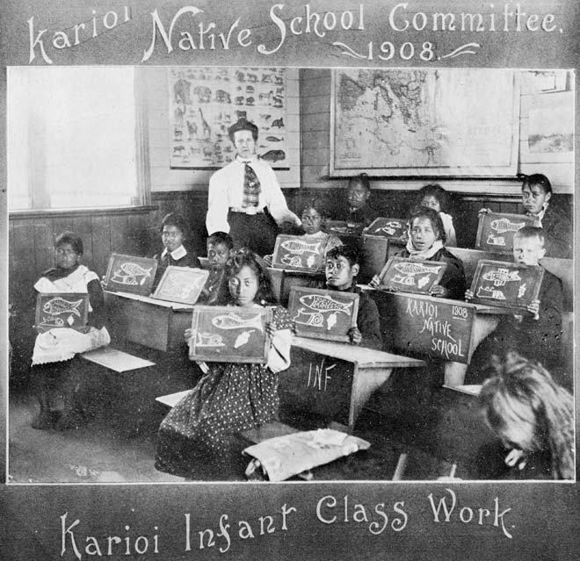
Then, there were Māori Native Schools
1867 - 1969
School was segregated and Māori were punished for speaking Te Reo Māori.
Image from https://teara.govt.nz/ Auckland City Libraries - Tāmaki Pātaka Kōrero, Sir George Grey Special Collections Reference: 7-A12343
The native schools system

Slide 32
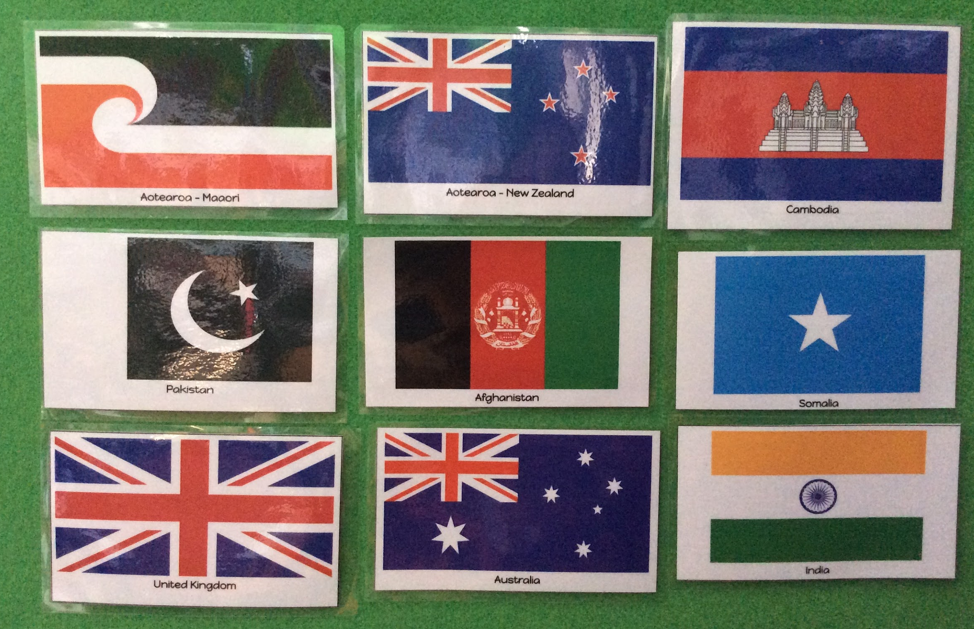
Now, our school is diverse.
There are at least 9 nationalities in our classroom and 16+ in our school.
We value, respect, and learn our pepeha, karakia, Te Reo Māori, Tikanga, and Kapahaka.

Slide 33
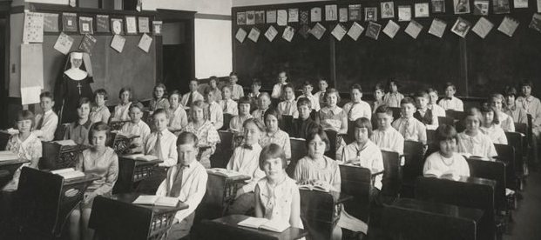
Then, the school classroom had rows of desks.
This Is What School Was Like 100 Years Ago

Slide 34
Now, our classroom looks very different.

Slide 35
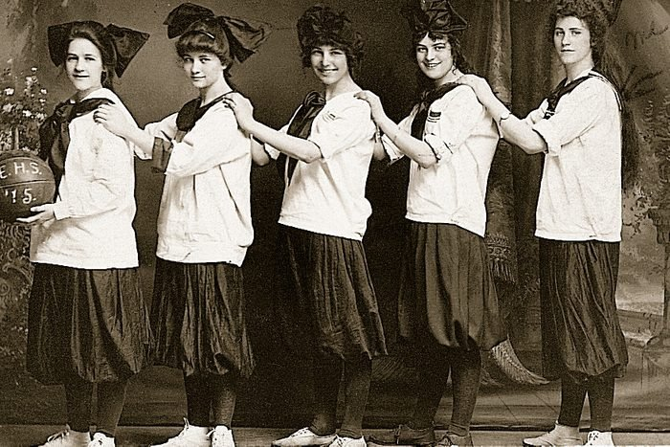
Sports Uniforms
This Is What School Was Like 100 Years Ago

Slide 36
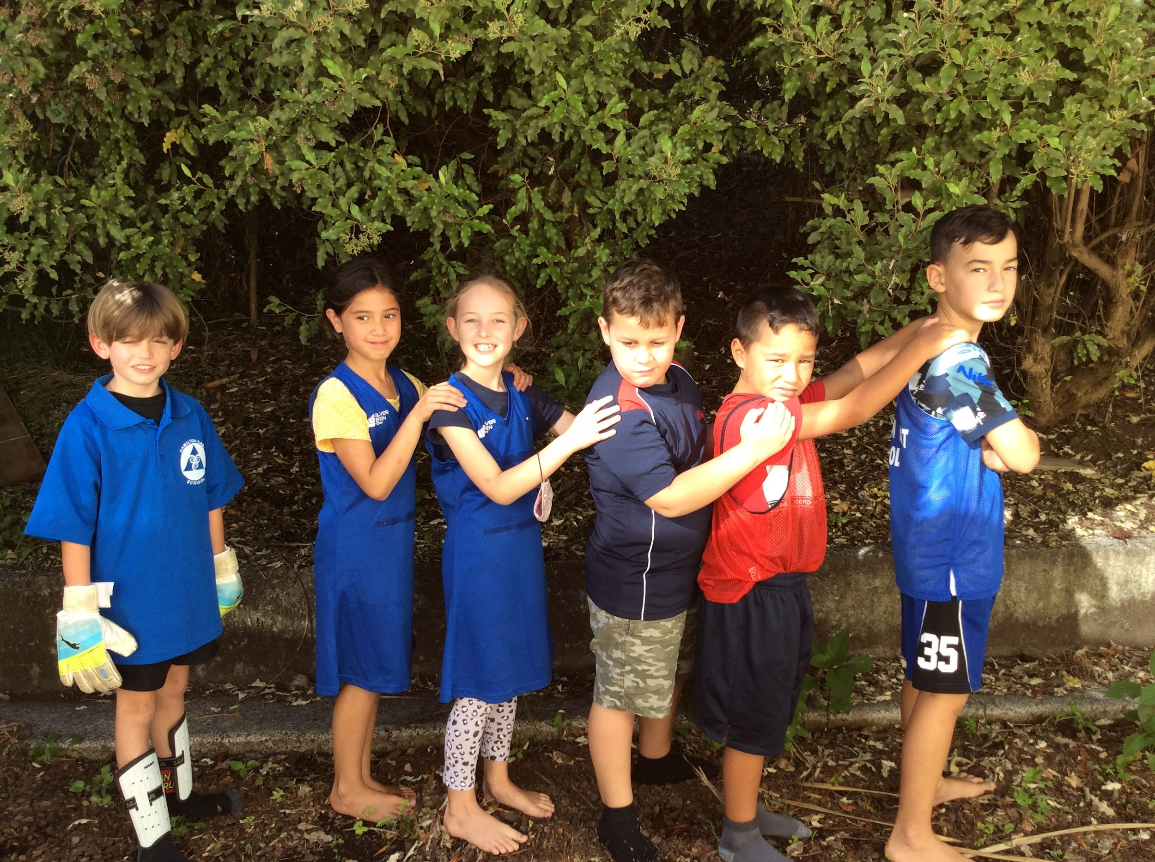
Hamilton East Sports Uniforms
This Is What School Was Like 100 Years Ago

Slide 37
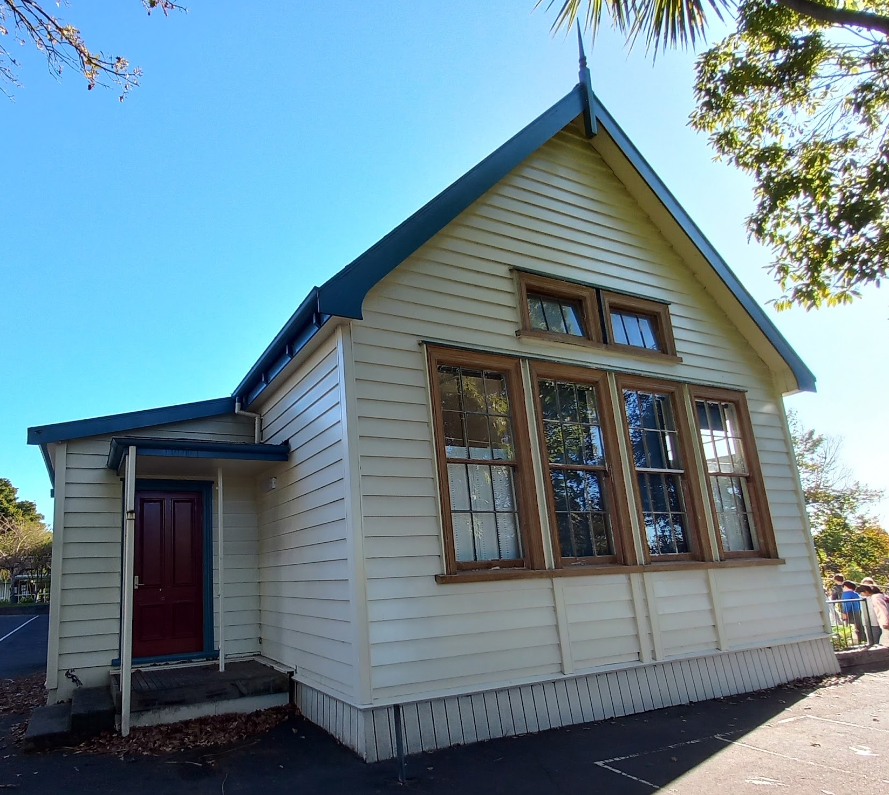
Then, our school only had one classroom.
The Education Board gave 25 pounds and Hamilton East Community contributed 25 pounds to establish our school.

Slide 38
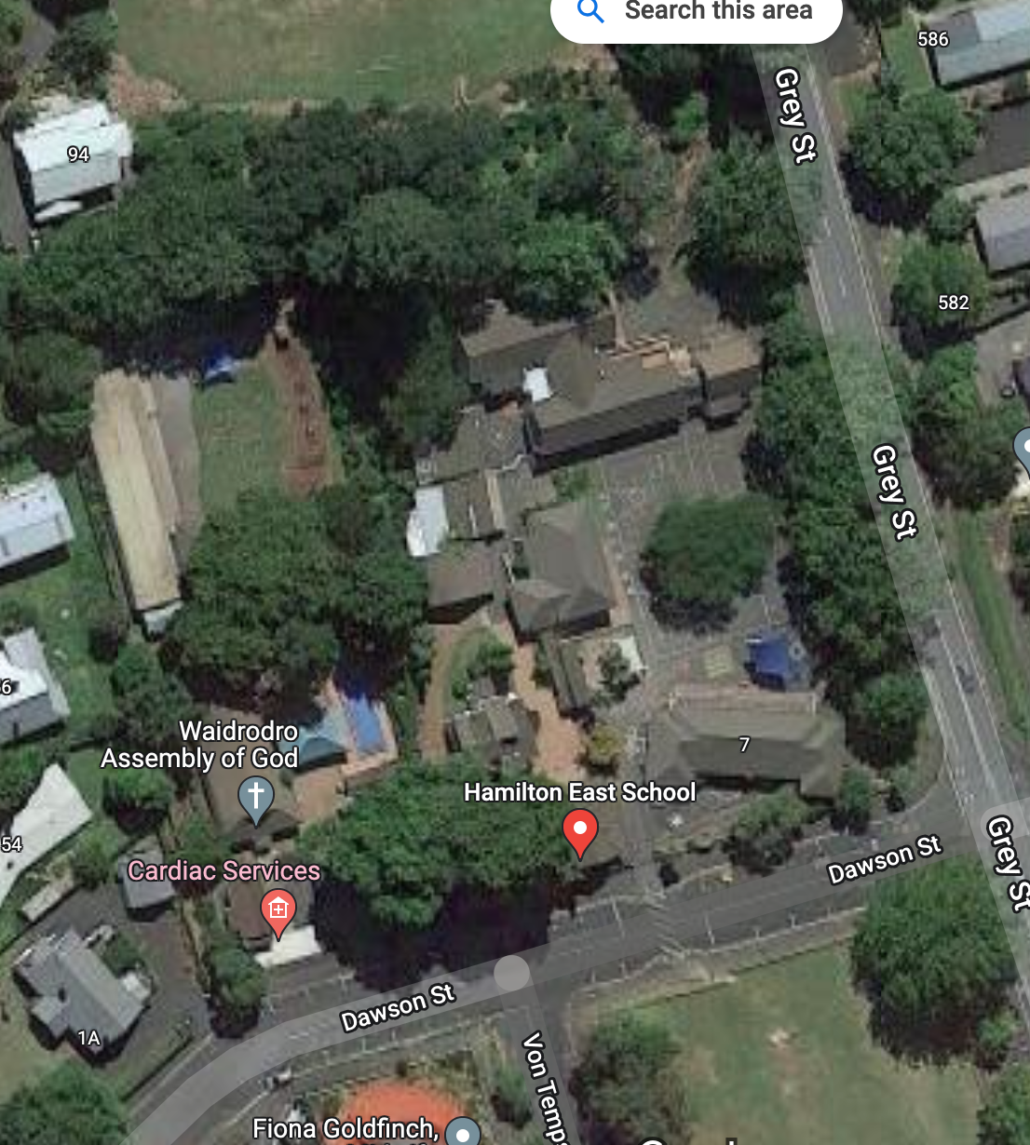
Our school has expanded …
Now we have 20 classrooms, one library, a resource room, a hall and an office and staffroom.
Now our school is worth MILLIONS!
NB: This is an old photo and doesn’t include the modern Totara classrooms.

Slide 39
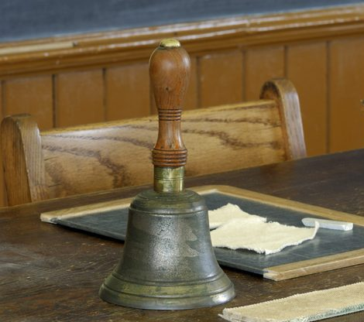
Then, the bell was handheld and students had
one chalkboard or slate each to write on.
This Is What School Was Like 100 Years Ago

Slide 40
Now our bell is electric and makes a loud RINGING sound.
We also still use an old handbell.

Slide 41
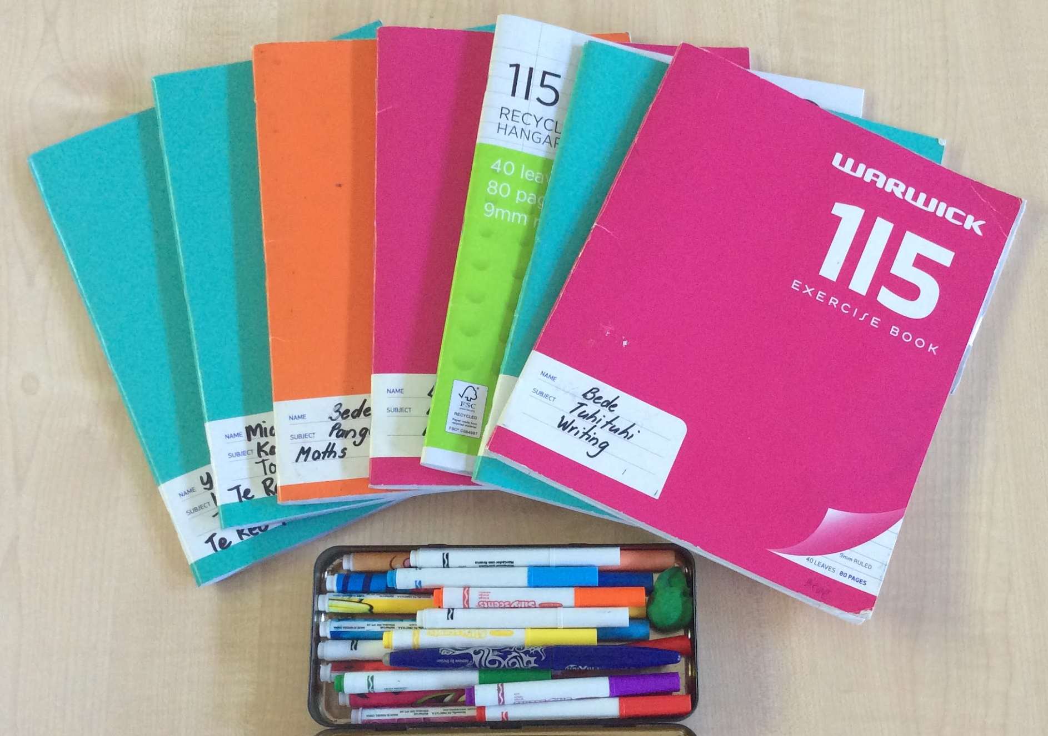
Now, we have an exercise book for each subject.

Slide 42
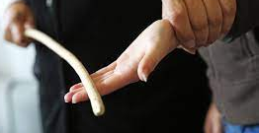
Then, punishment was hands-on.

Slide 43
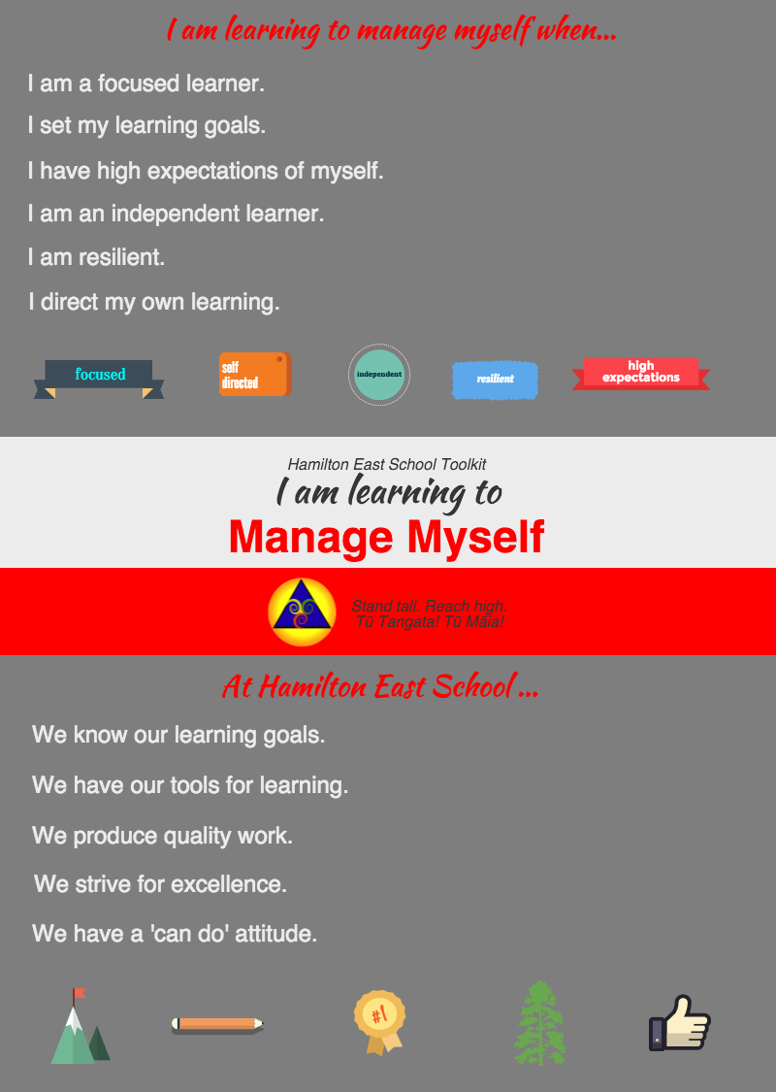
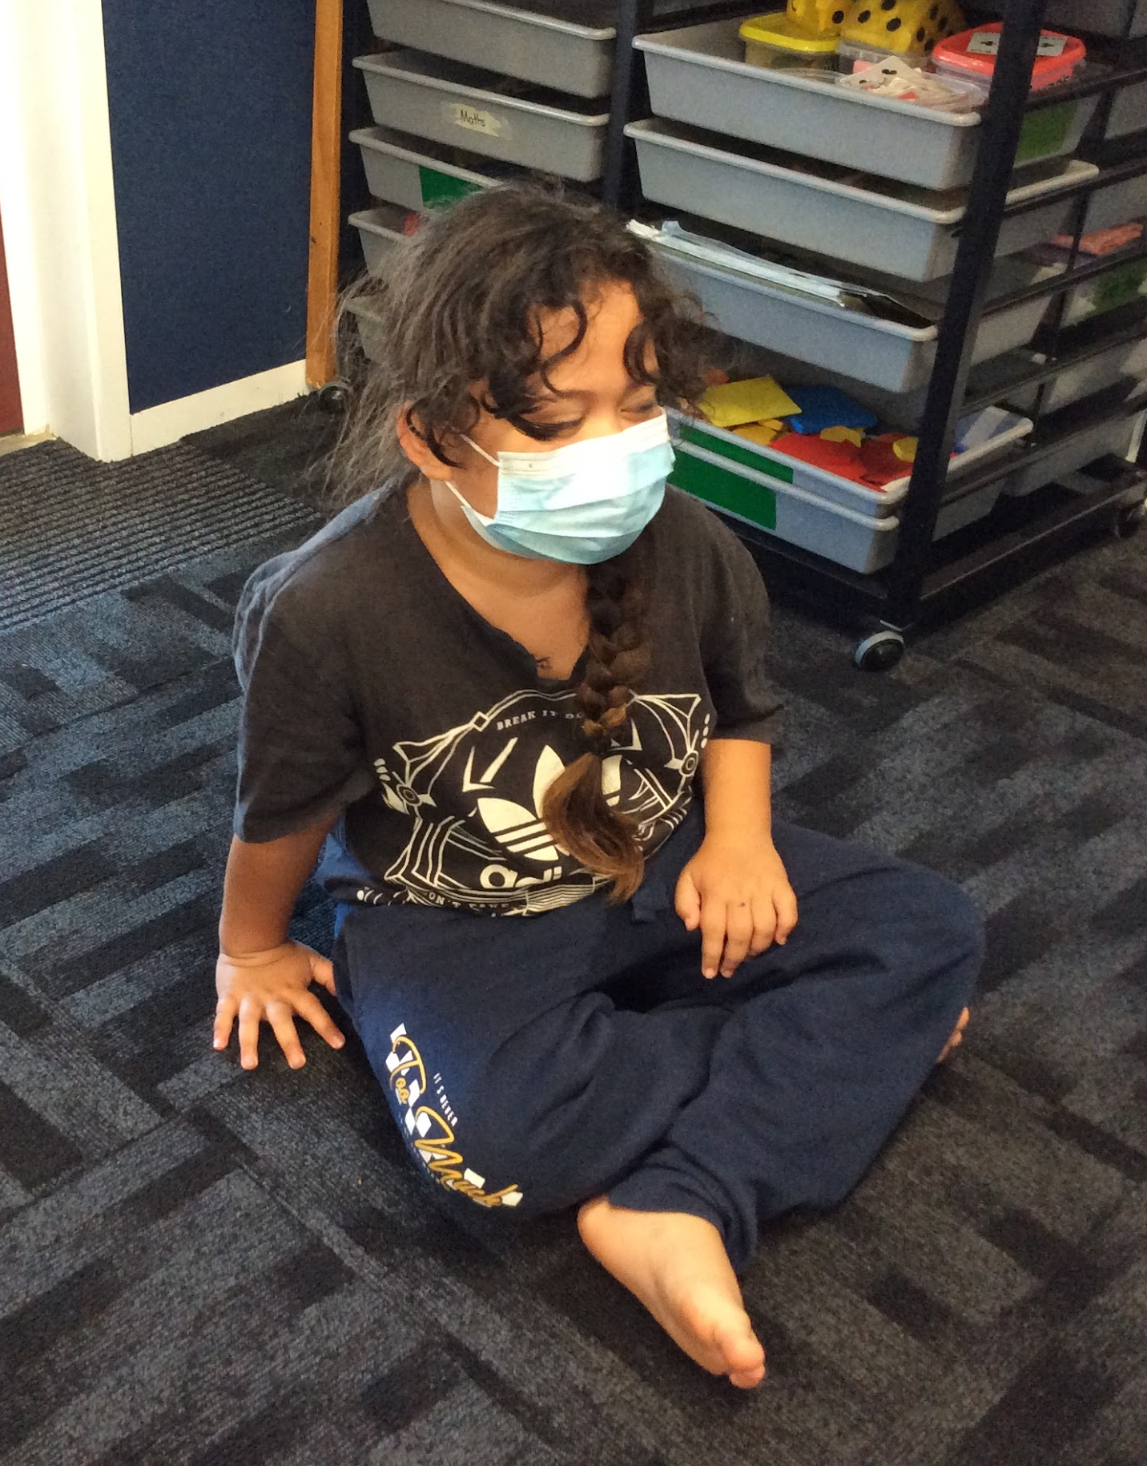
Now, we use the Hamilton East School Tool Kit,
thinking time, and reflective conversations.

Slide 44
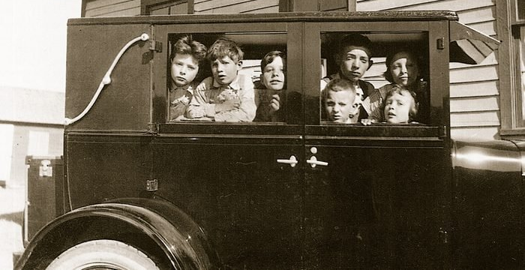
Then, some classes could fit in the teacher’s car.
This Is What School Was Like 100 Years Ago

Slide 45
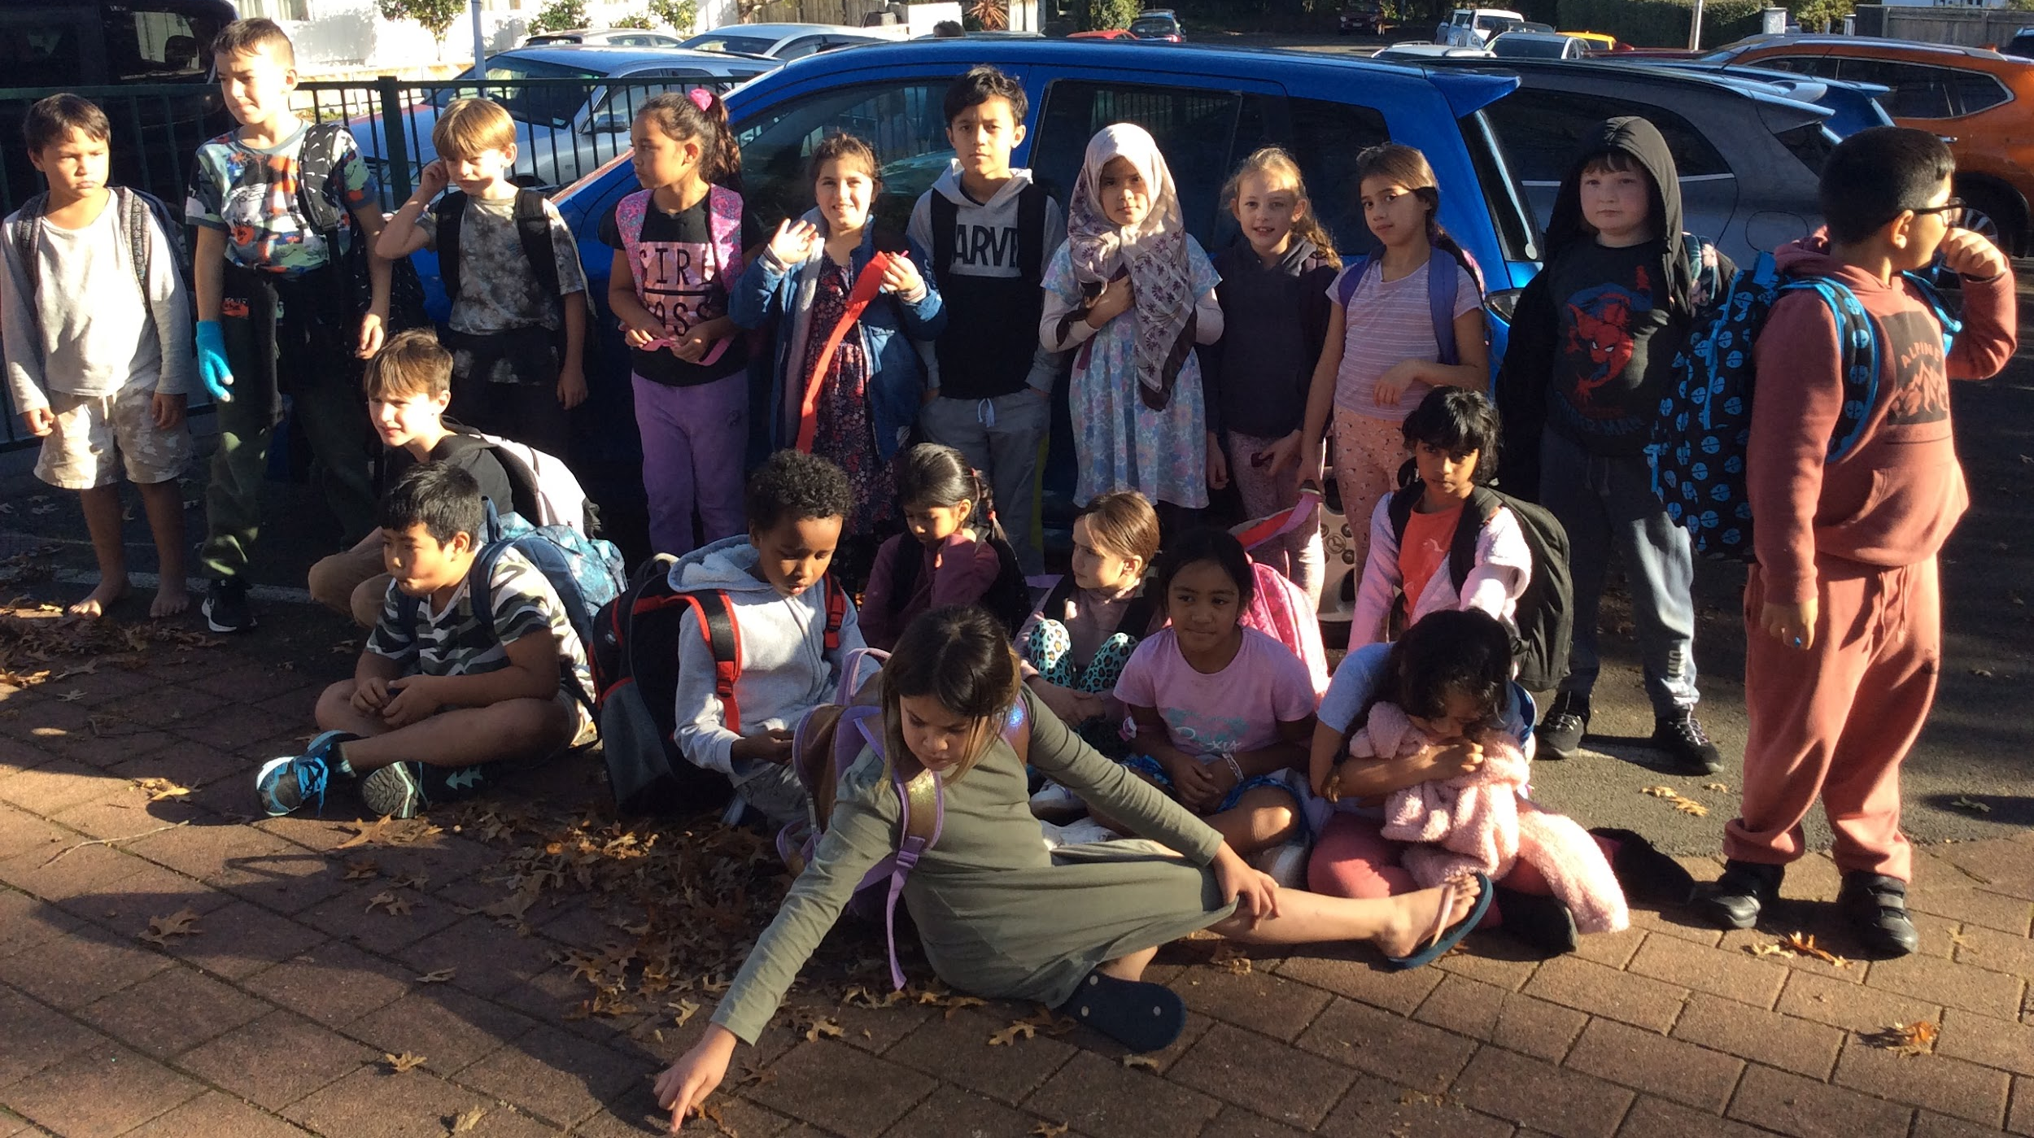
Now, there’s no way we could all fit into one car!

Slide 46
Then, classroom technology was limited.
This Is What School Was Like 100 Years Ago

Slide 47
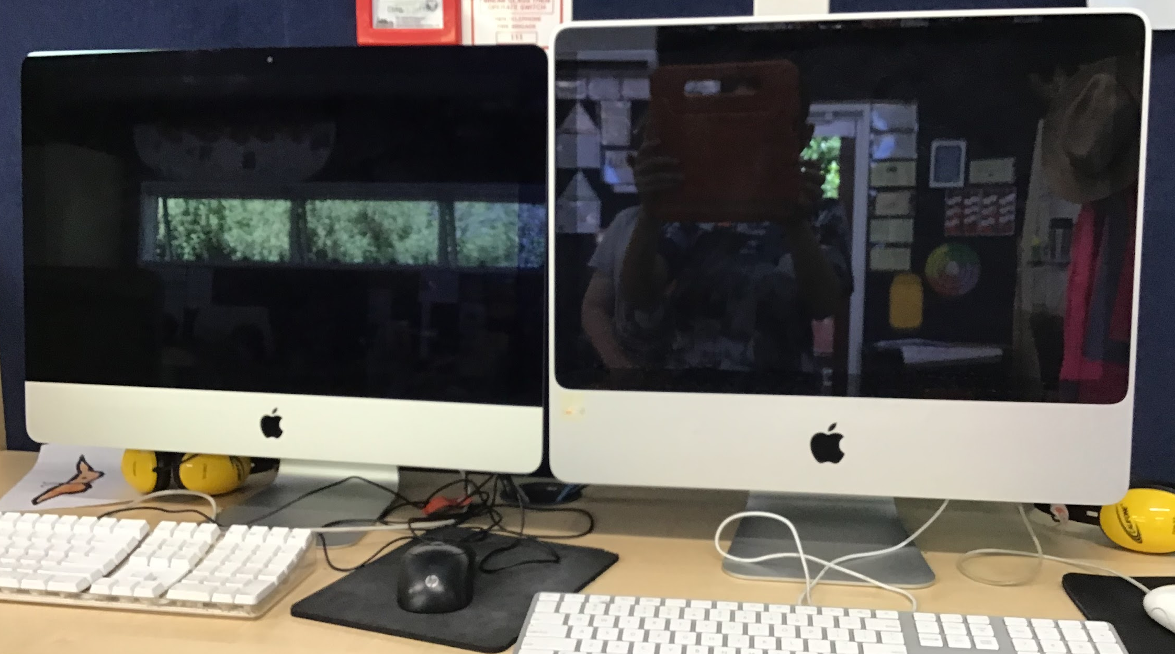
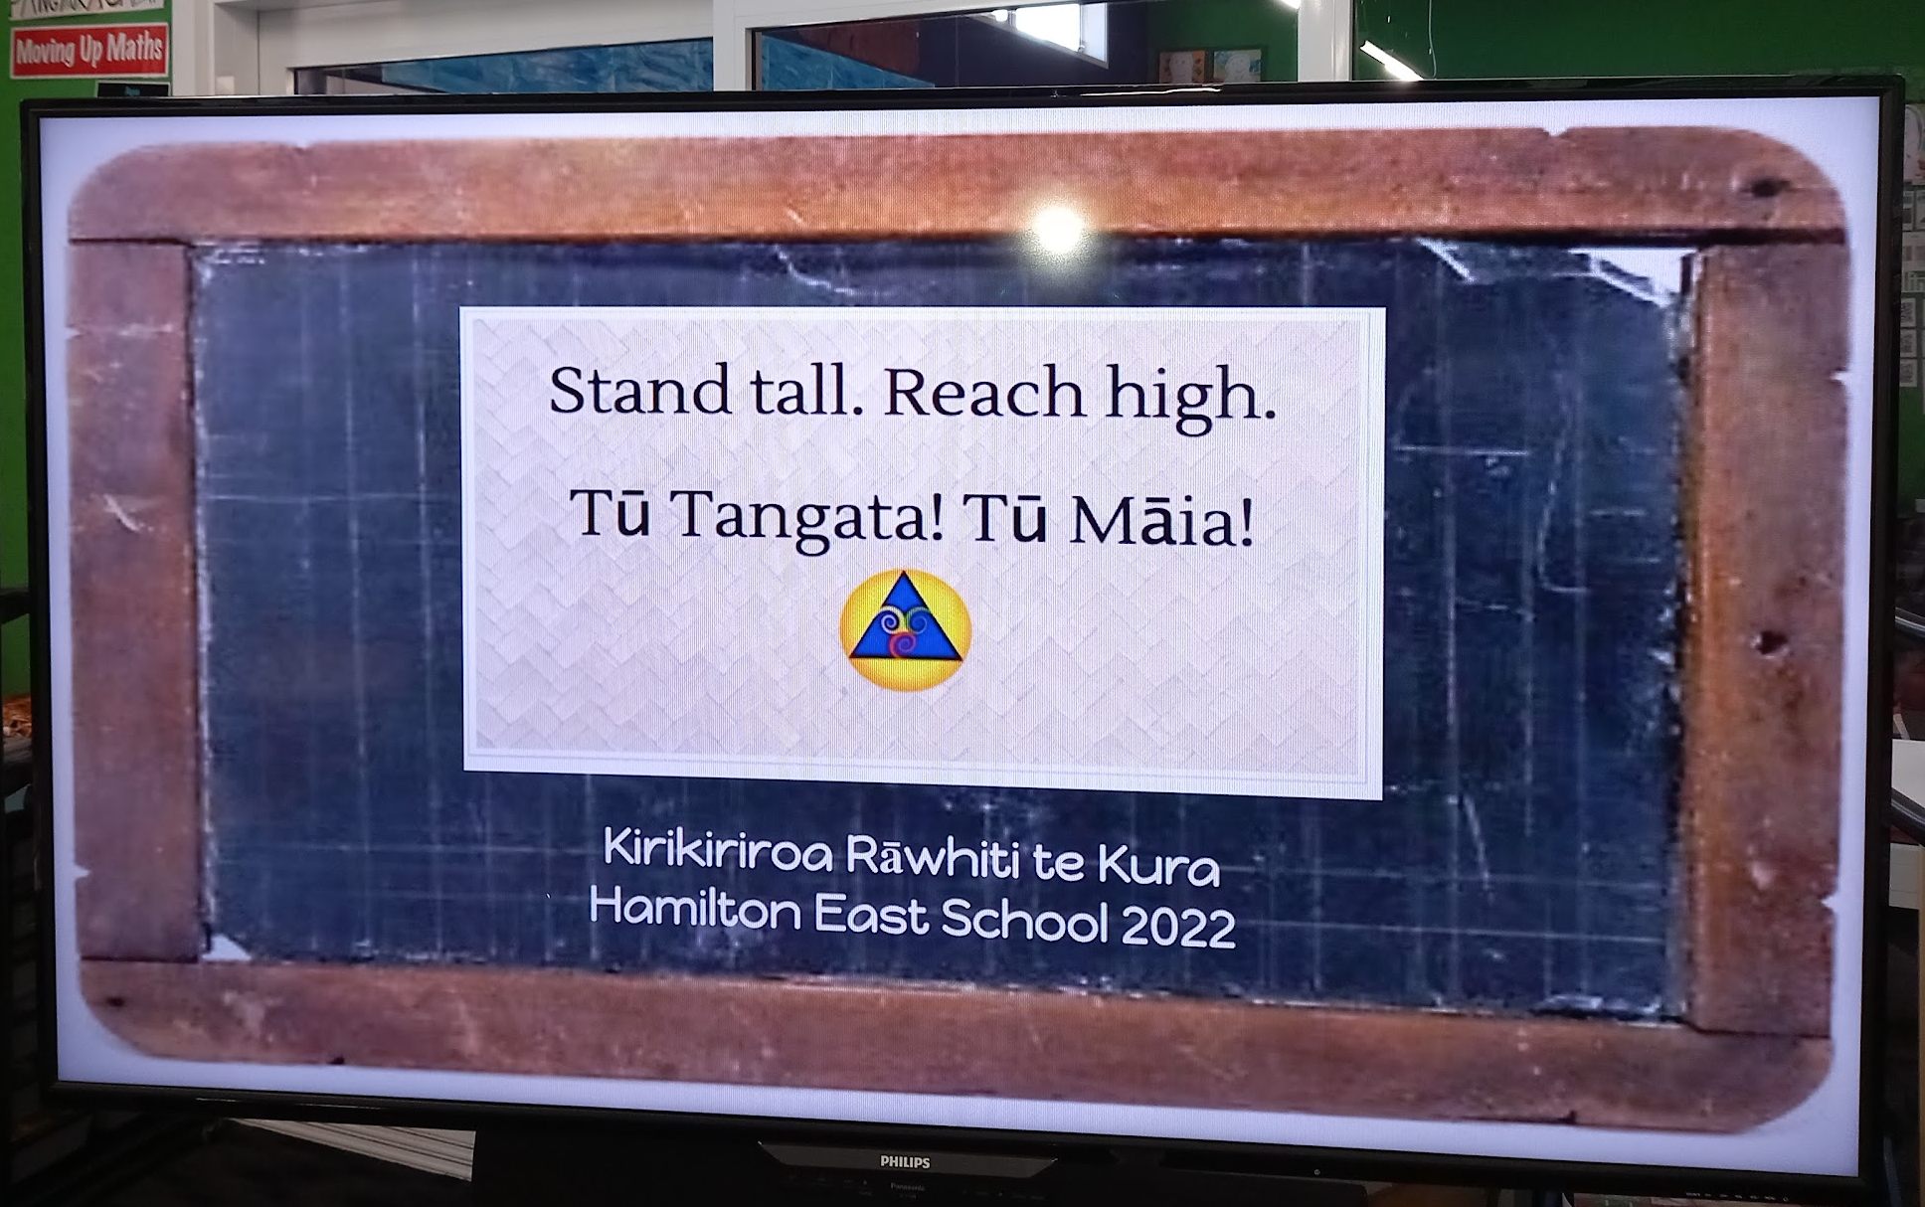
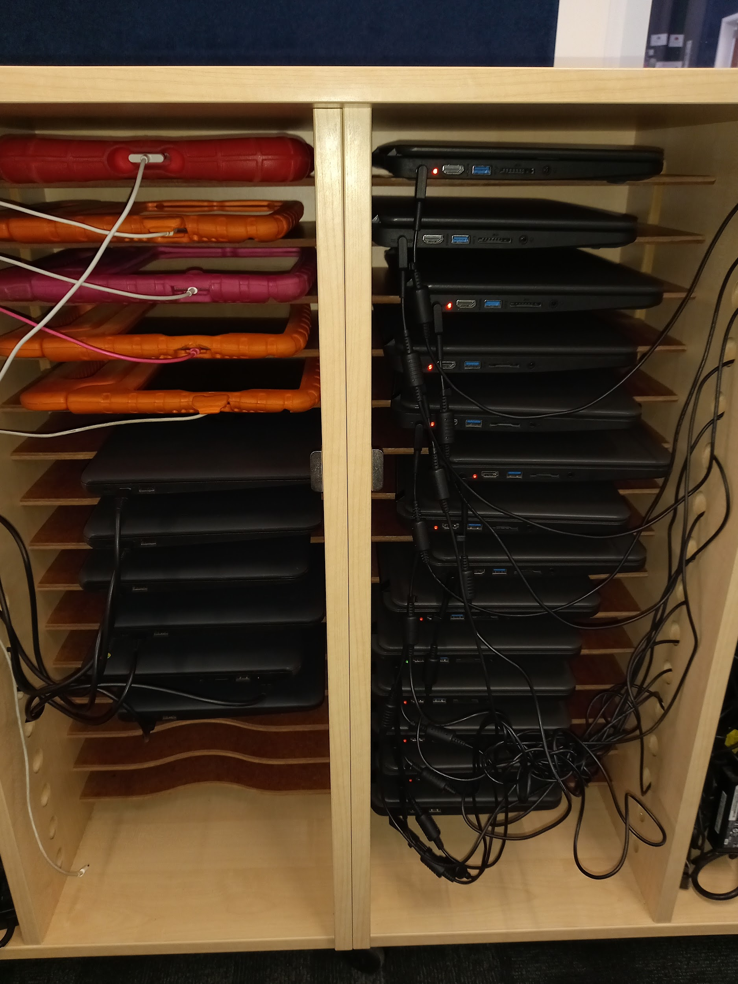
Now, We have a range of classroom technology including Ipads, chromebooks, digital screens, and headphones.

Slide 48
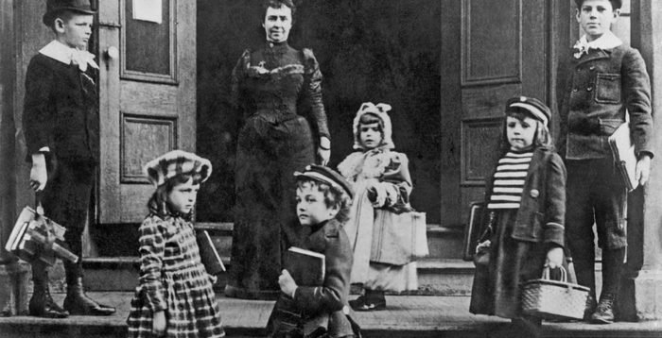
Clothes, school bags and lunch boxes
This Is What School Was Like 100 Years Ago

Slide 49
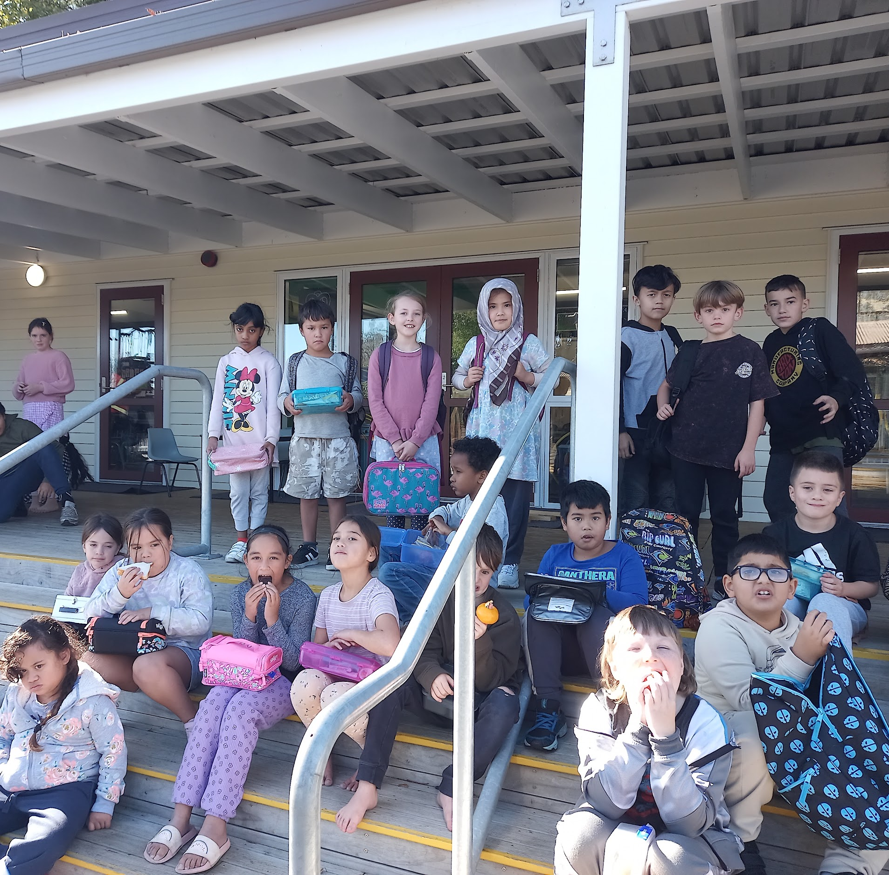
Clothes, school bags and lunch boxes

Slide 50
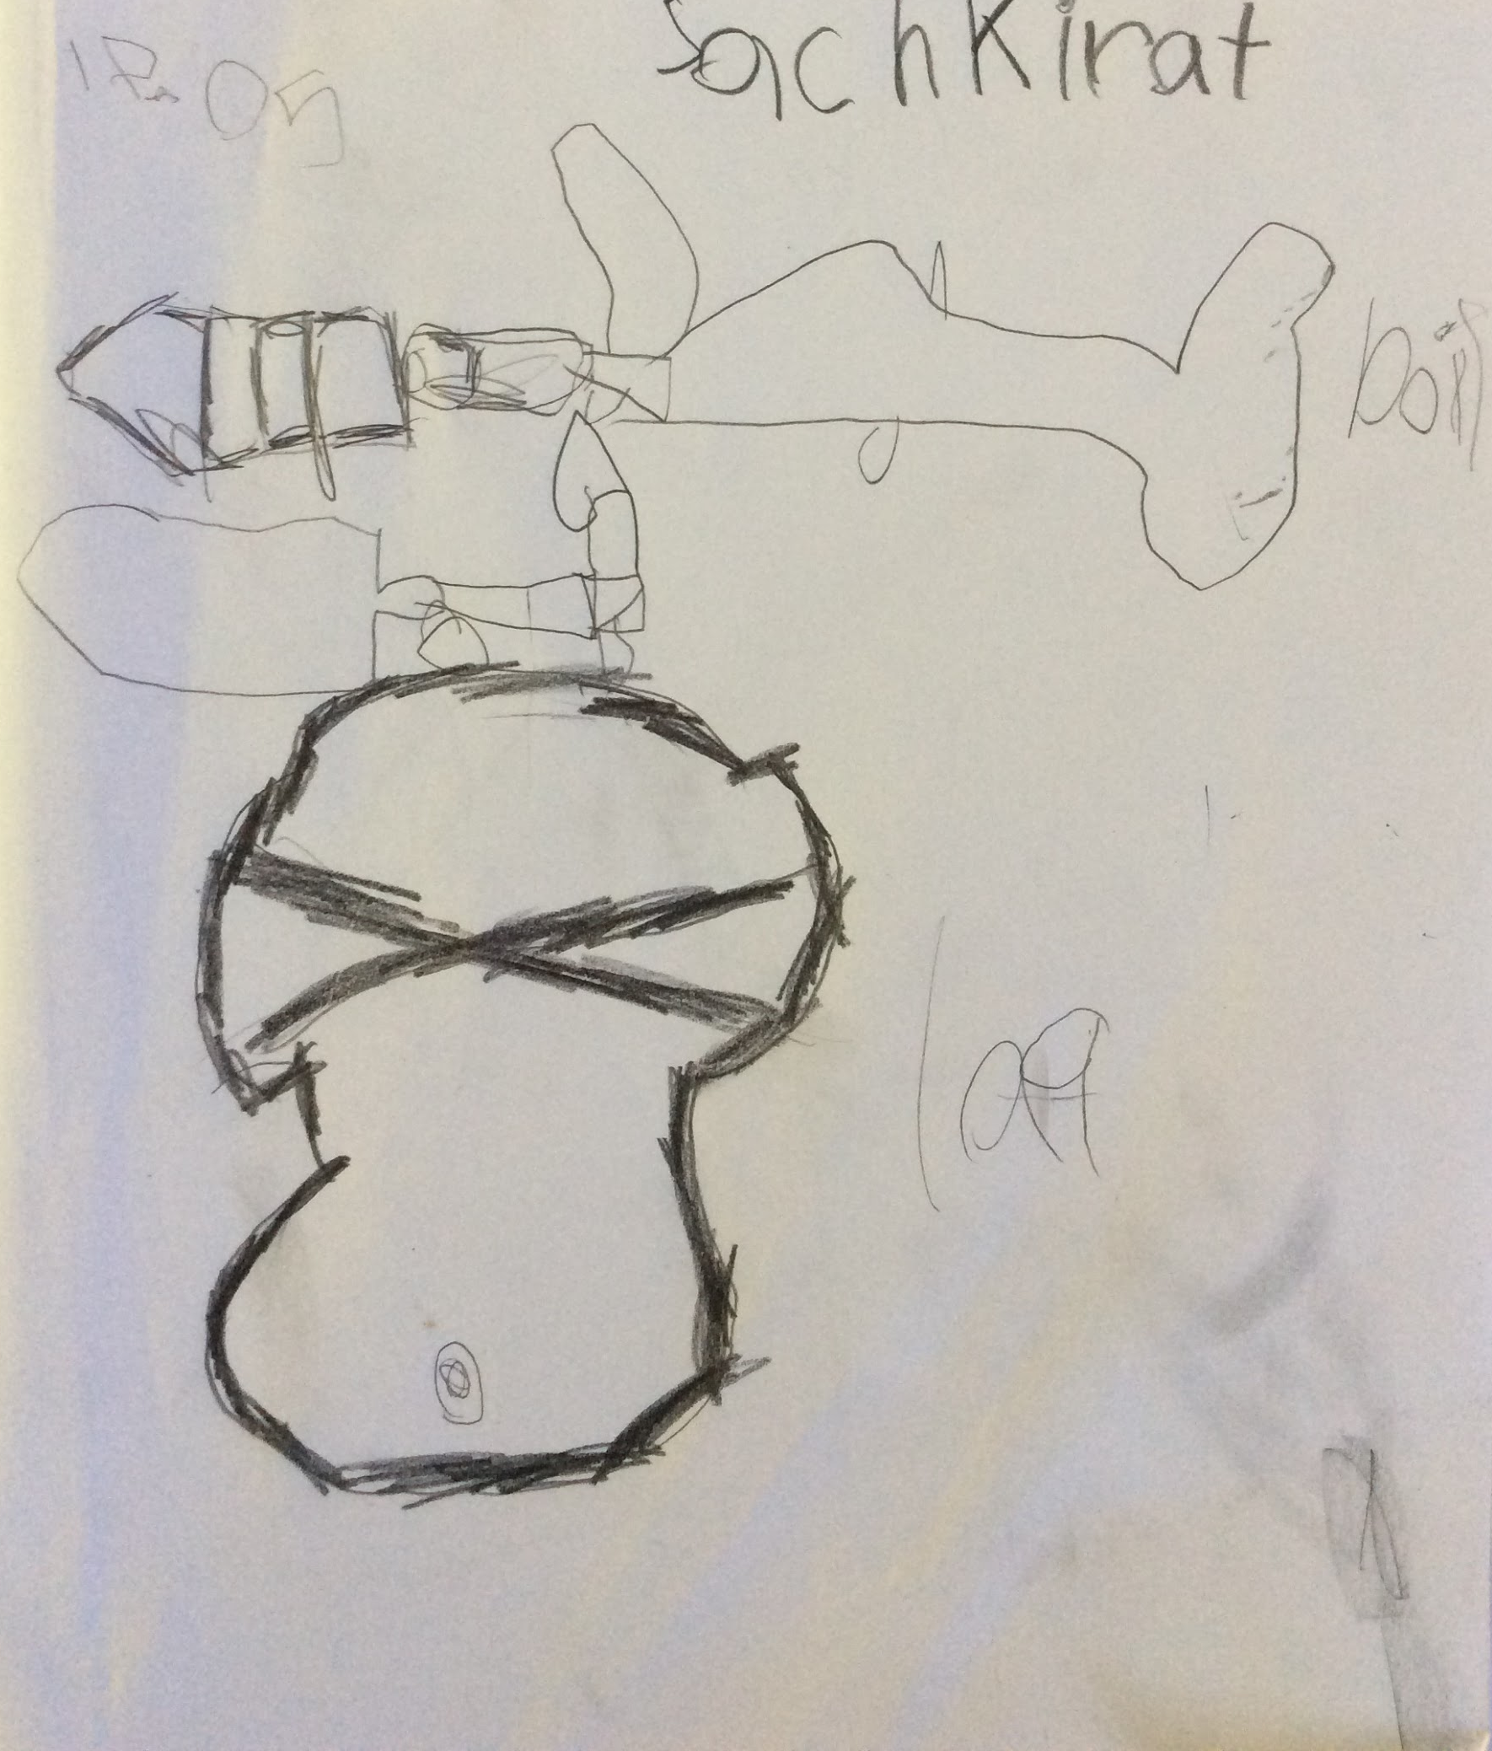
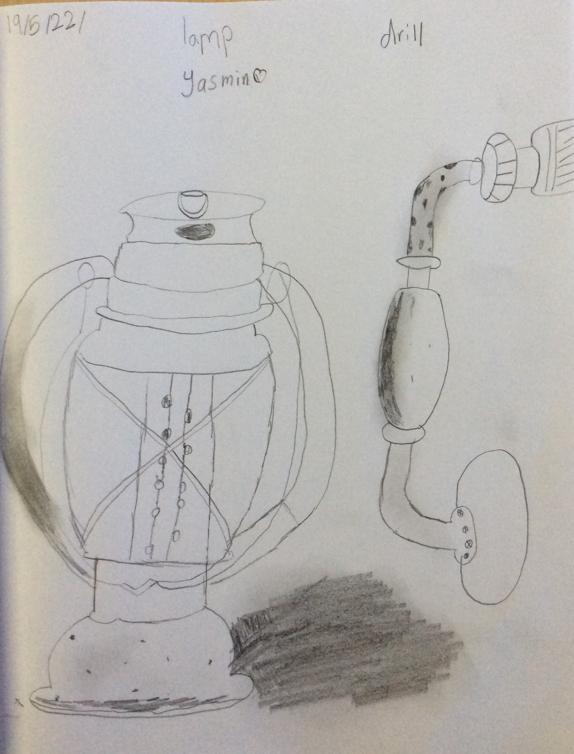

Slide 51
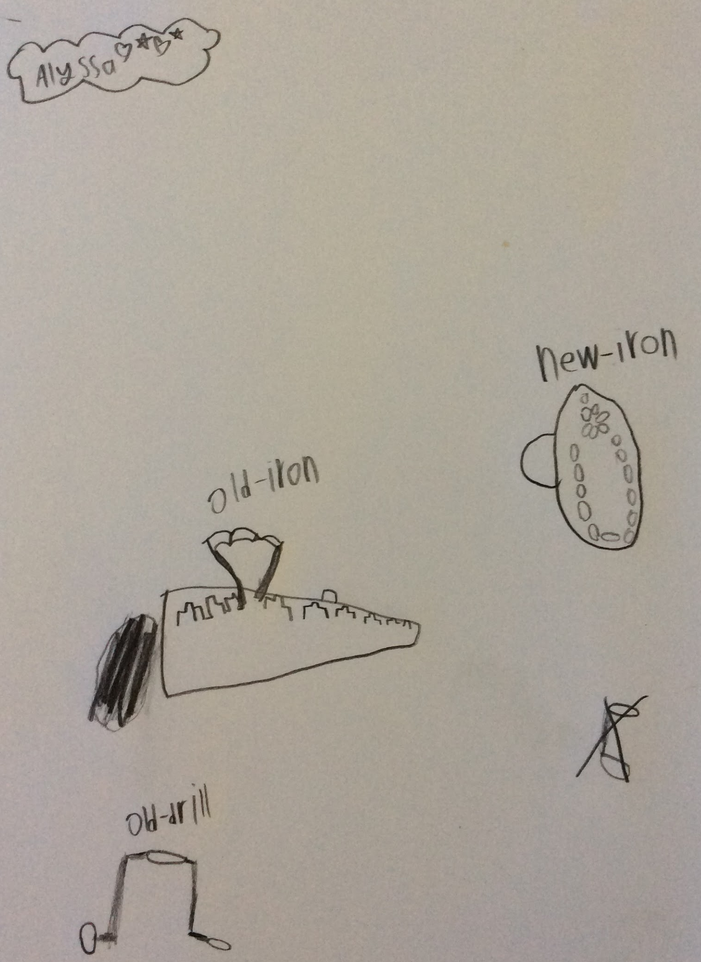

Slide 52
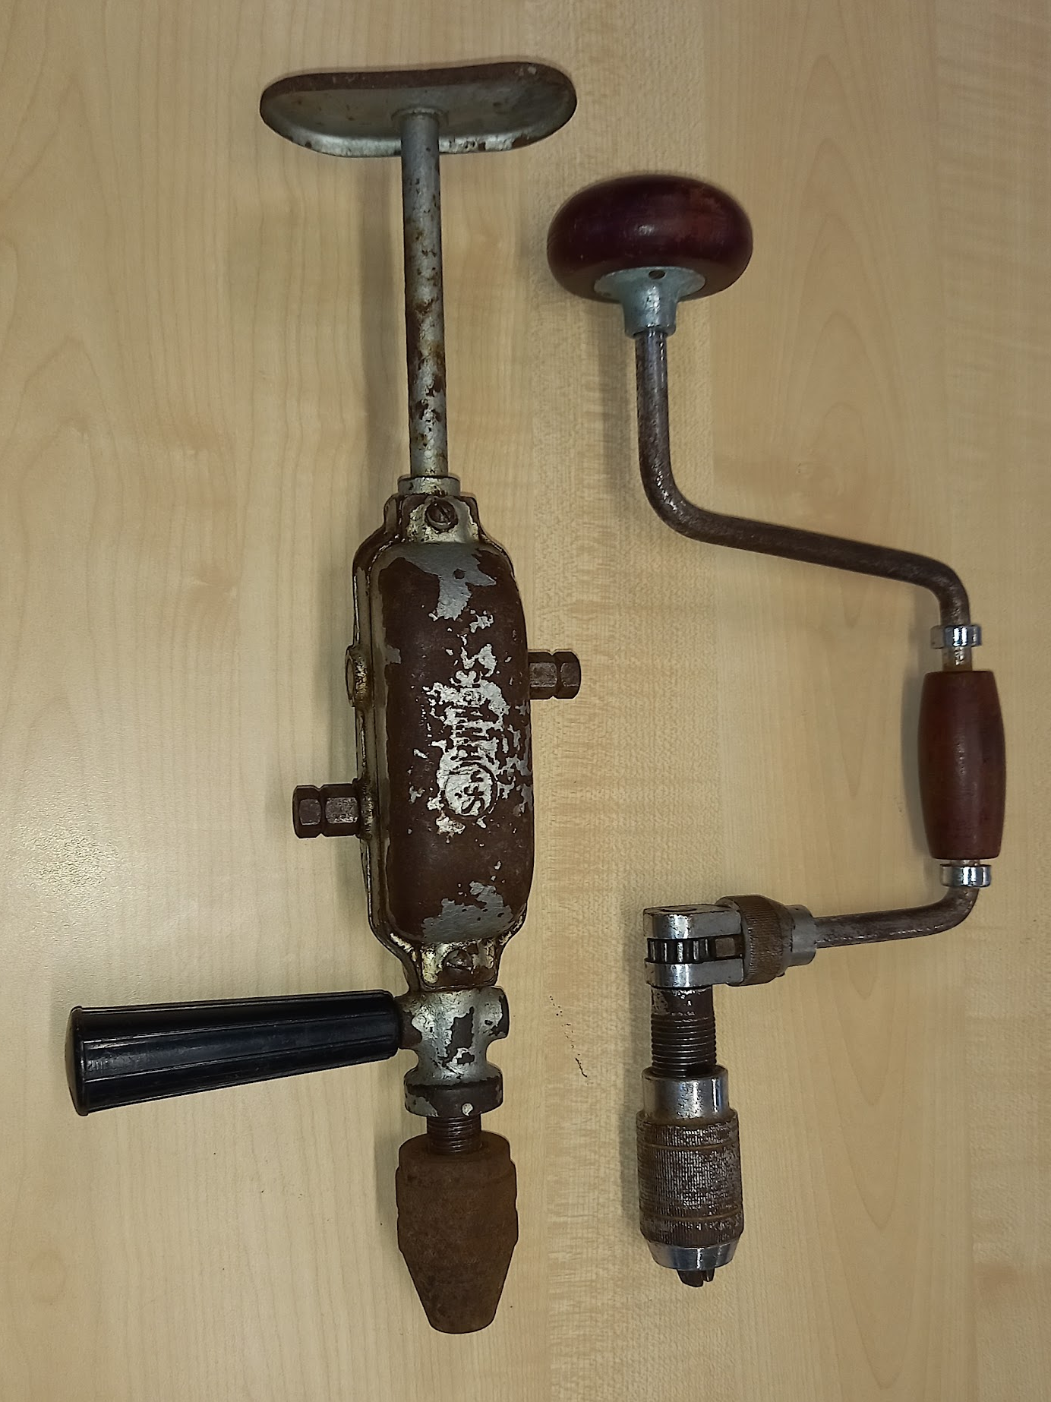
Building Tools
Then, drills were very heavy and hand held. It took a very long time to build a classroom. The drills were made out of metal and wood.
Because of this you would become very strong.

Slide 53
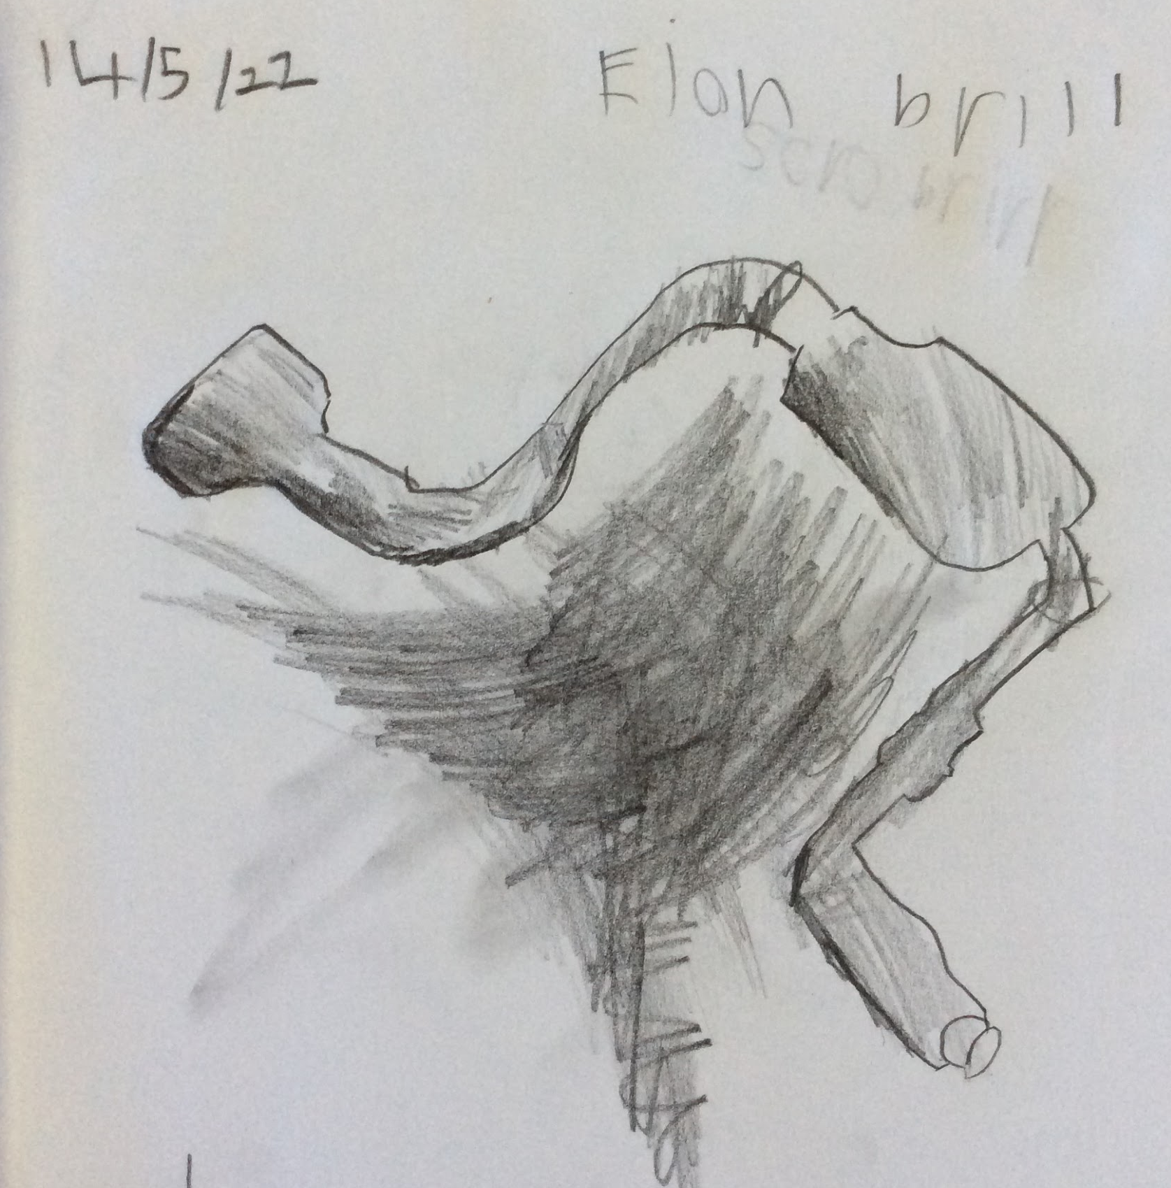
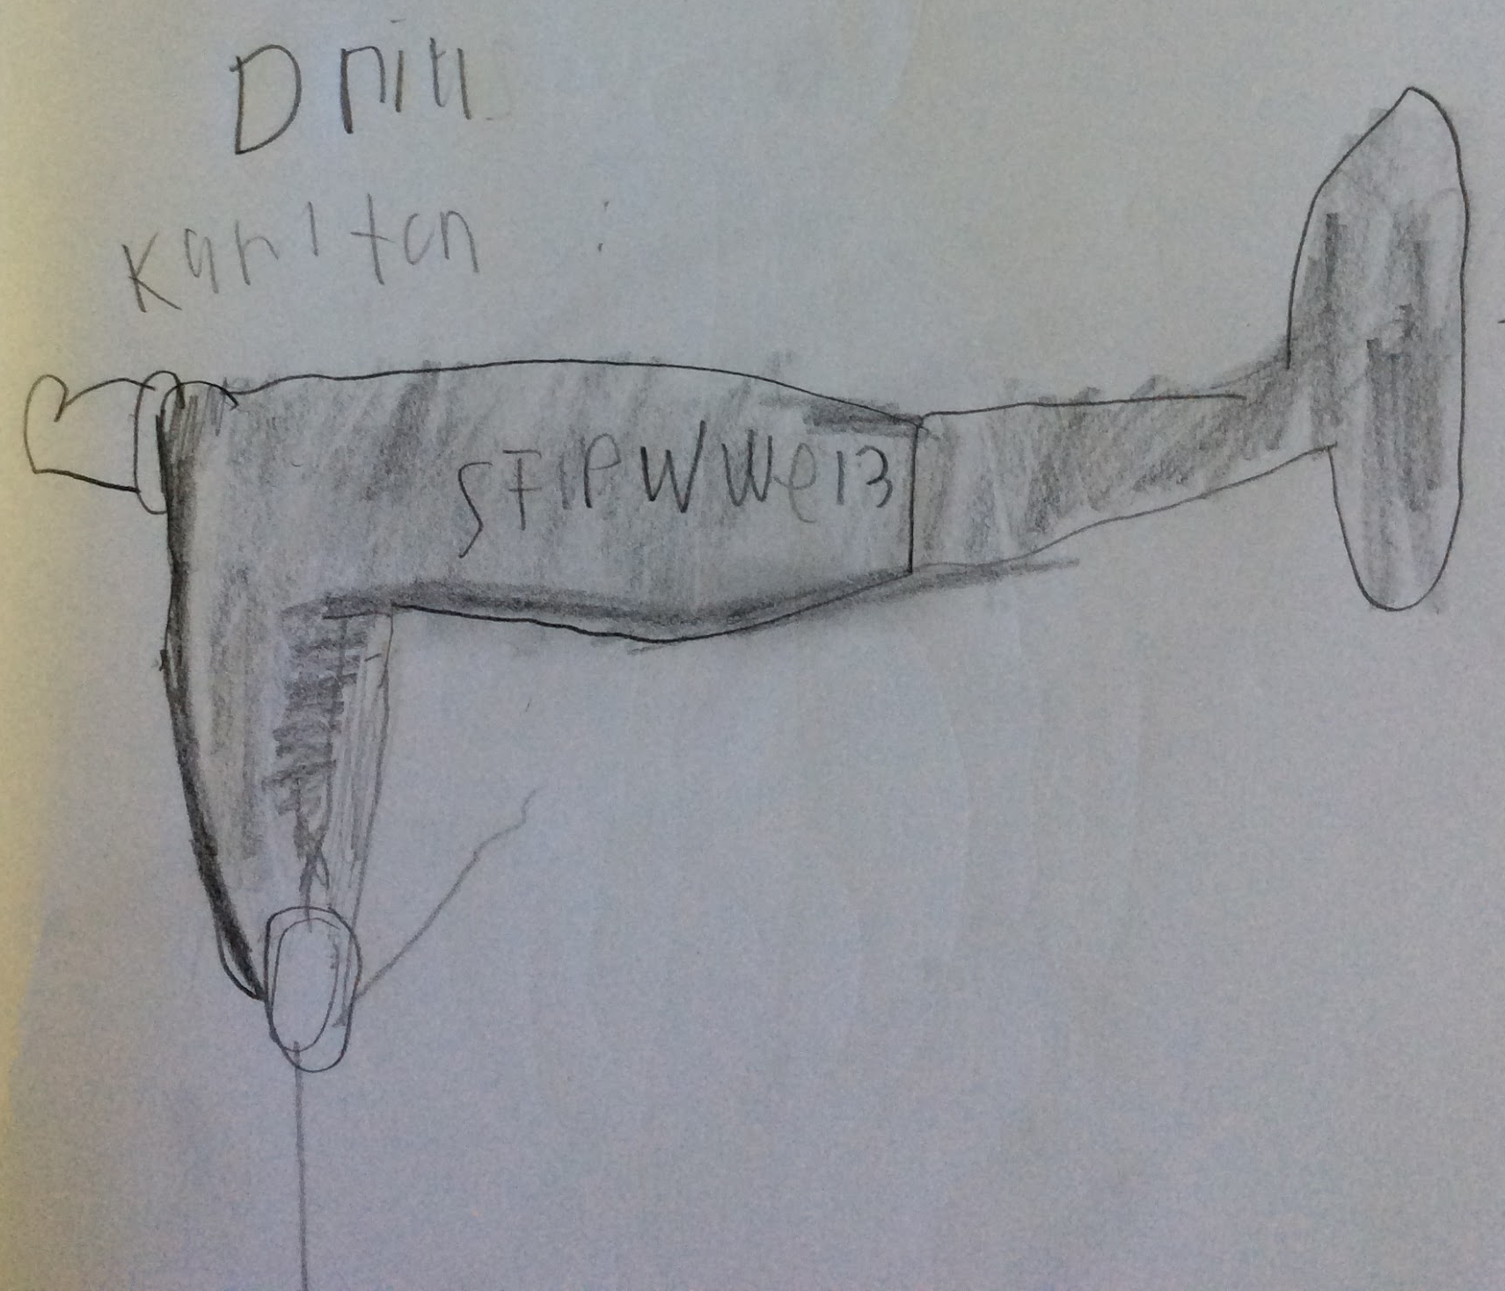

Slide 54
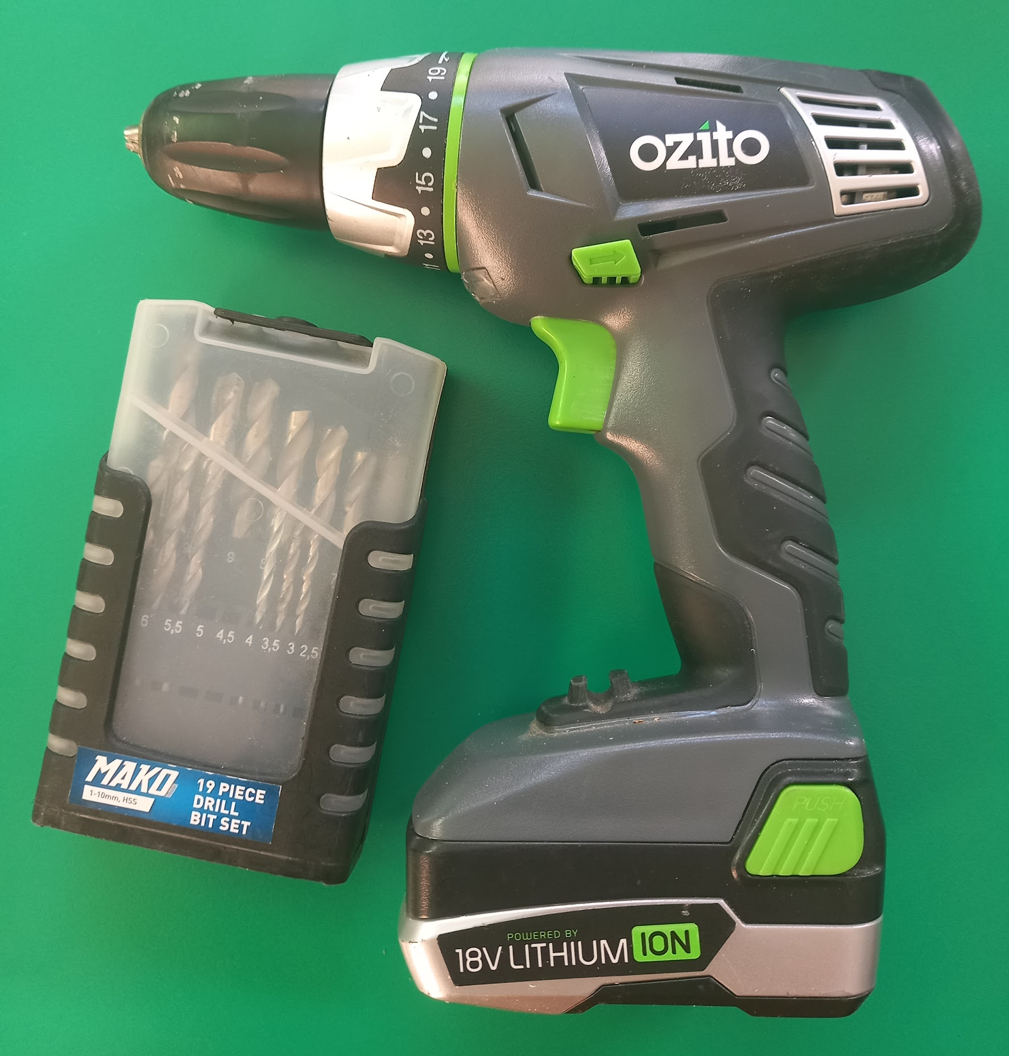
Building Tools
Now, drills are lighter and many have batteries or connect to electricity. It makes the job much quicker. The drills are made out of metal and plastic.
How to Use a Power Drill

Slide 55
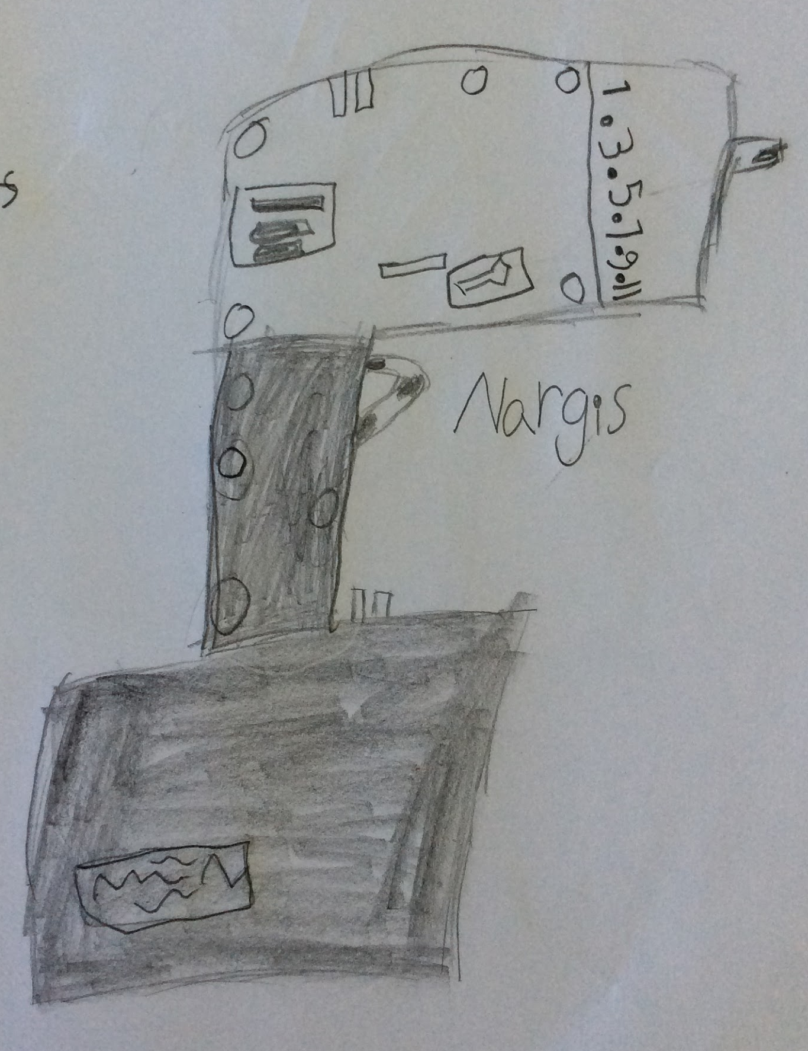

Slide 56
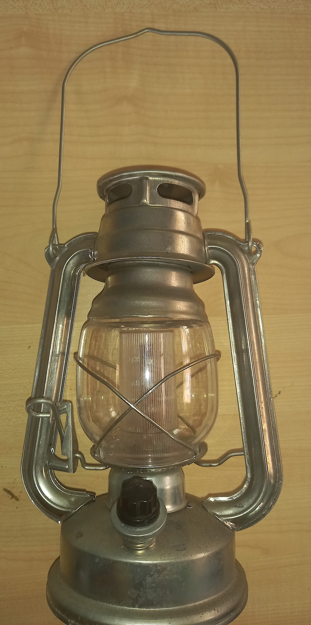
Lighting
Then, candles and kerosine lanterns were used to light buildings.
How to Use an Oil Lantern.

Slide 57
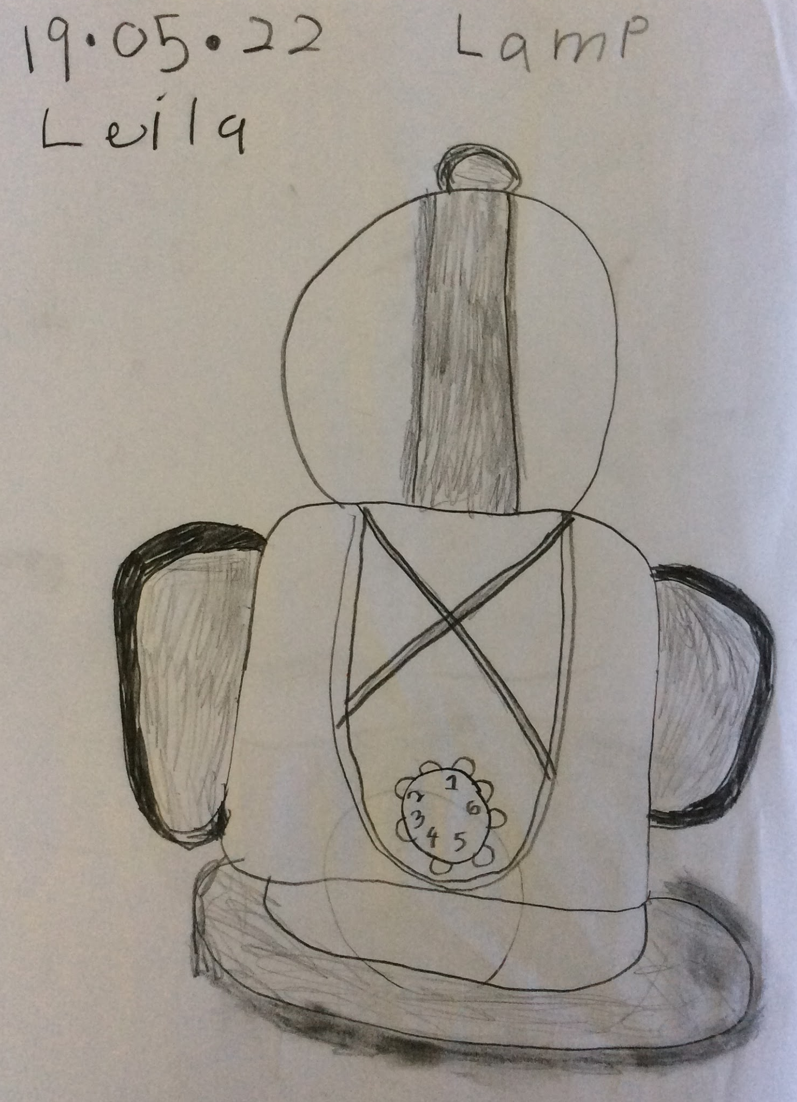
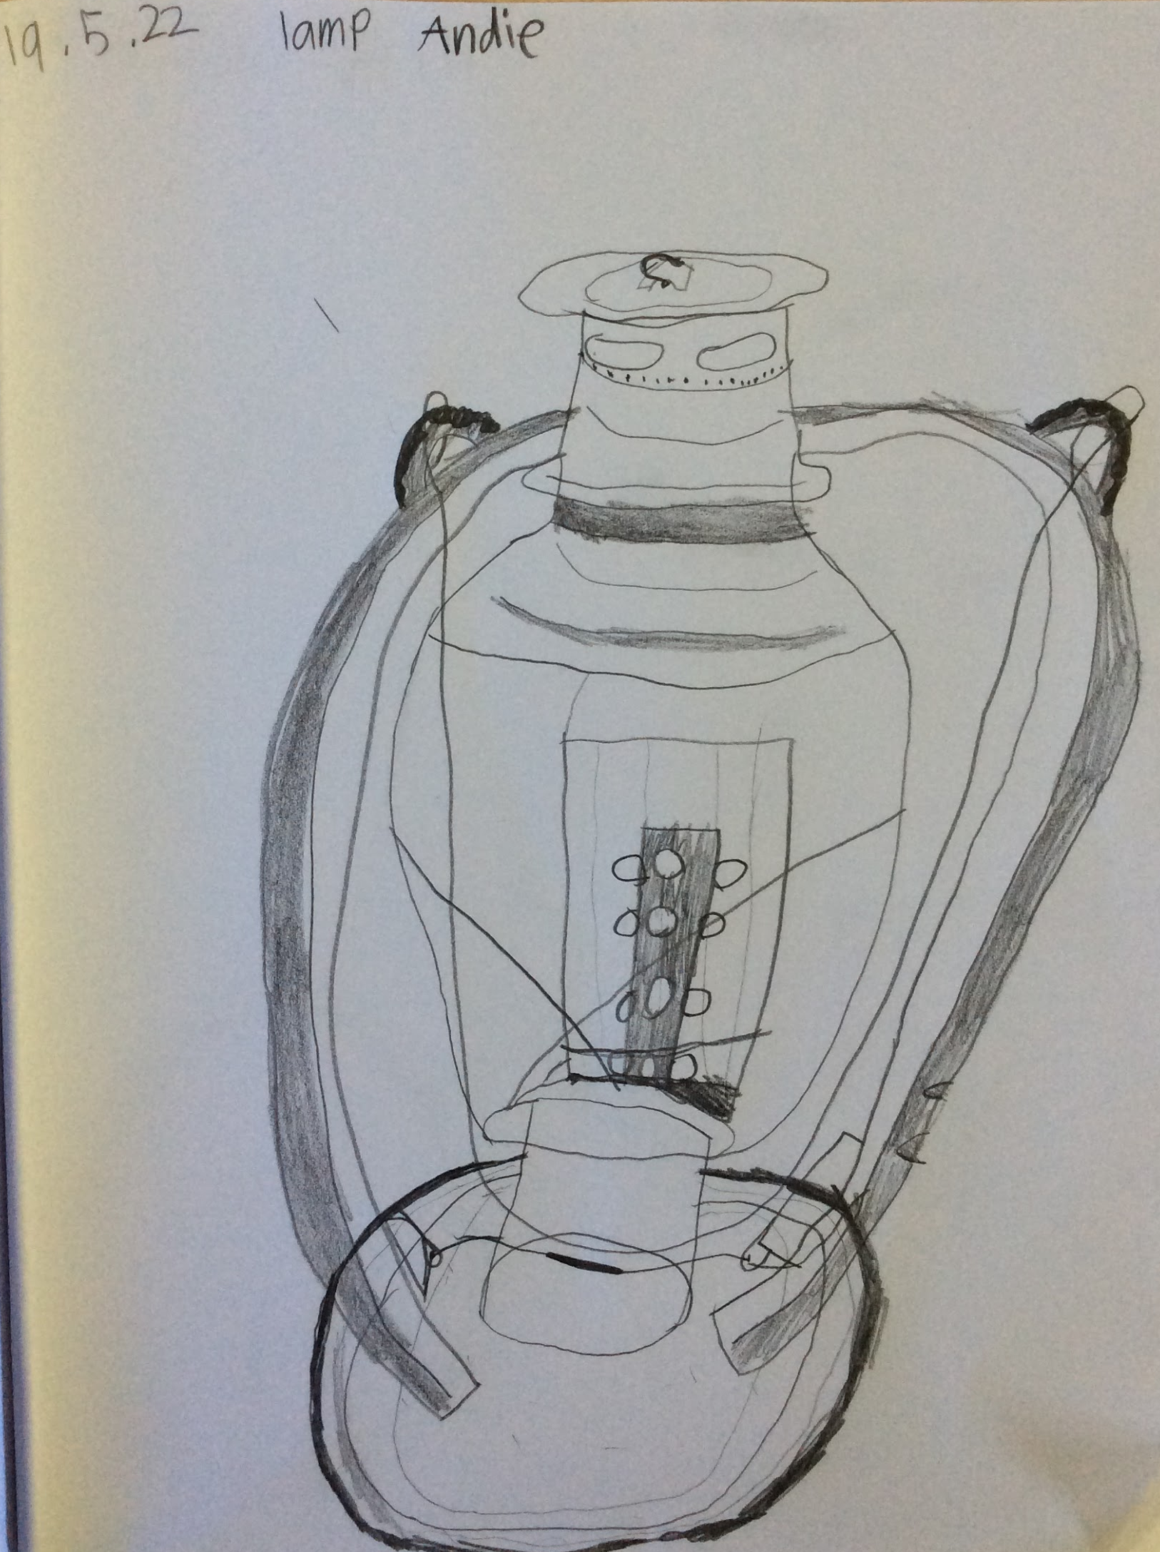

Slide 58
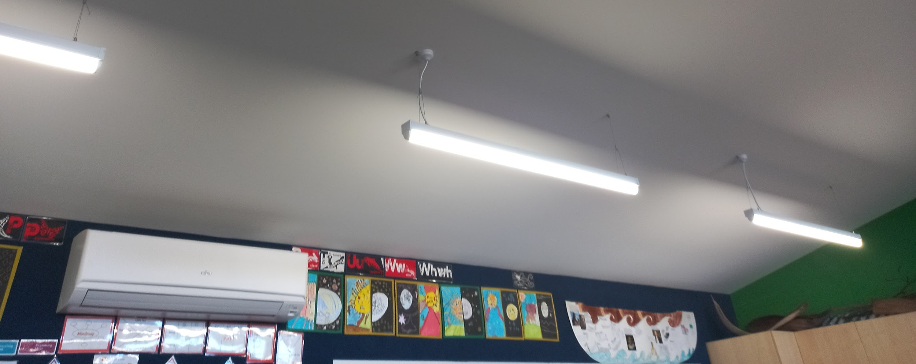
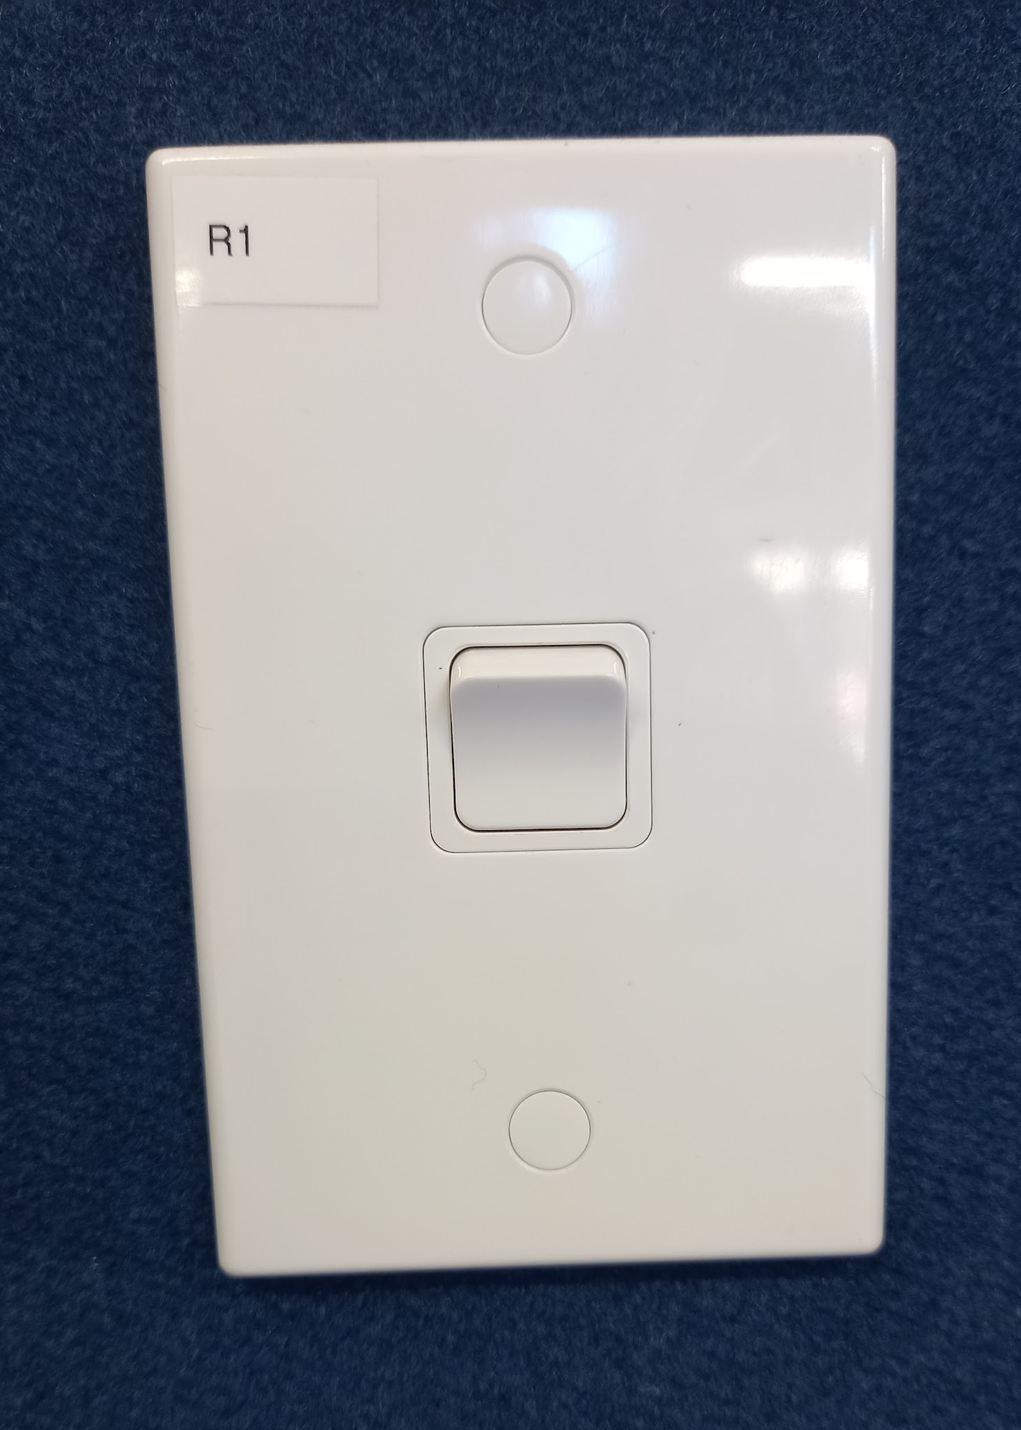
Now, with a flick of the switch we can have light.
The electricity we use is created by using
Hydro power (from the Waikato river).

Slide 59
Coal Irons
Then, coal irons were used to press clothes. The coal was put into the casing to make the iron hot.

Slide 60
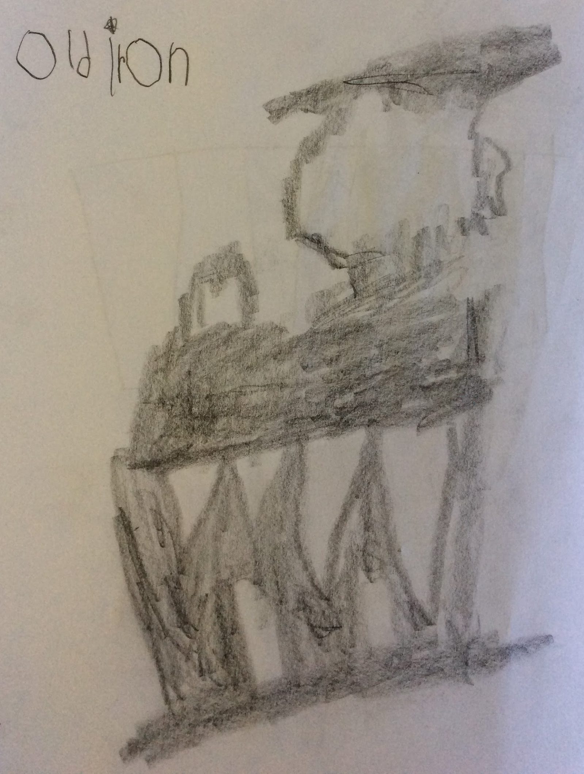
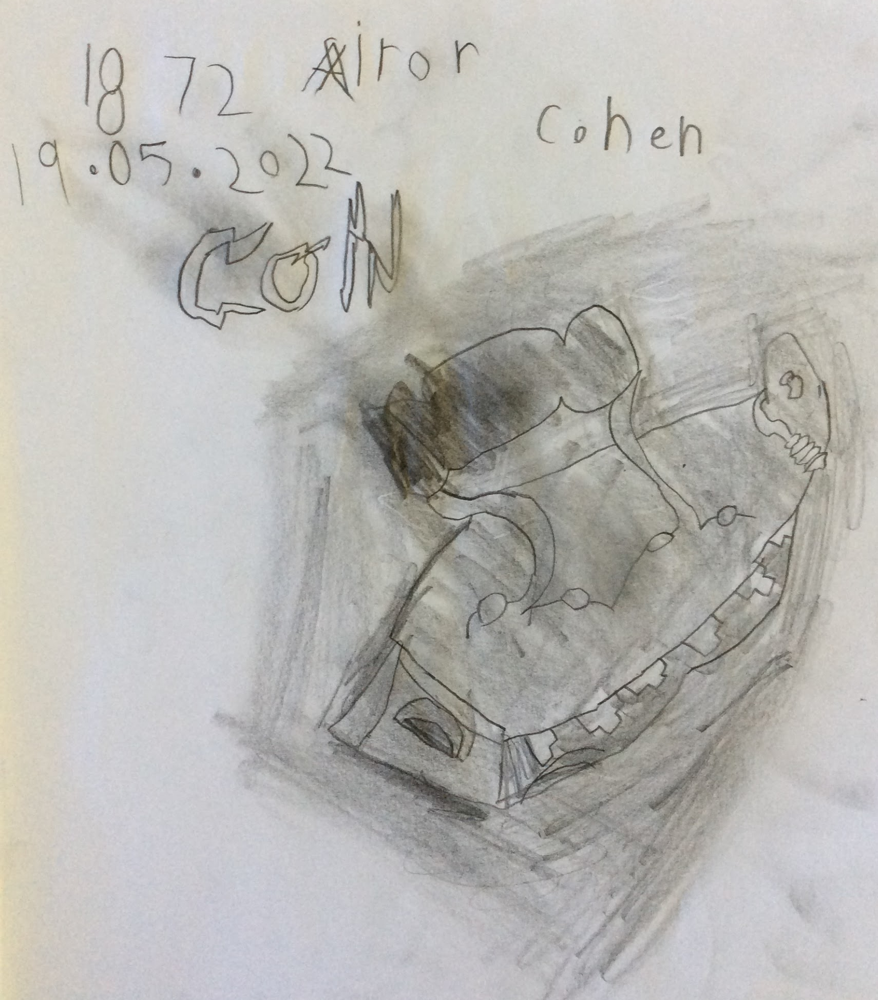
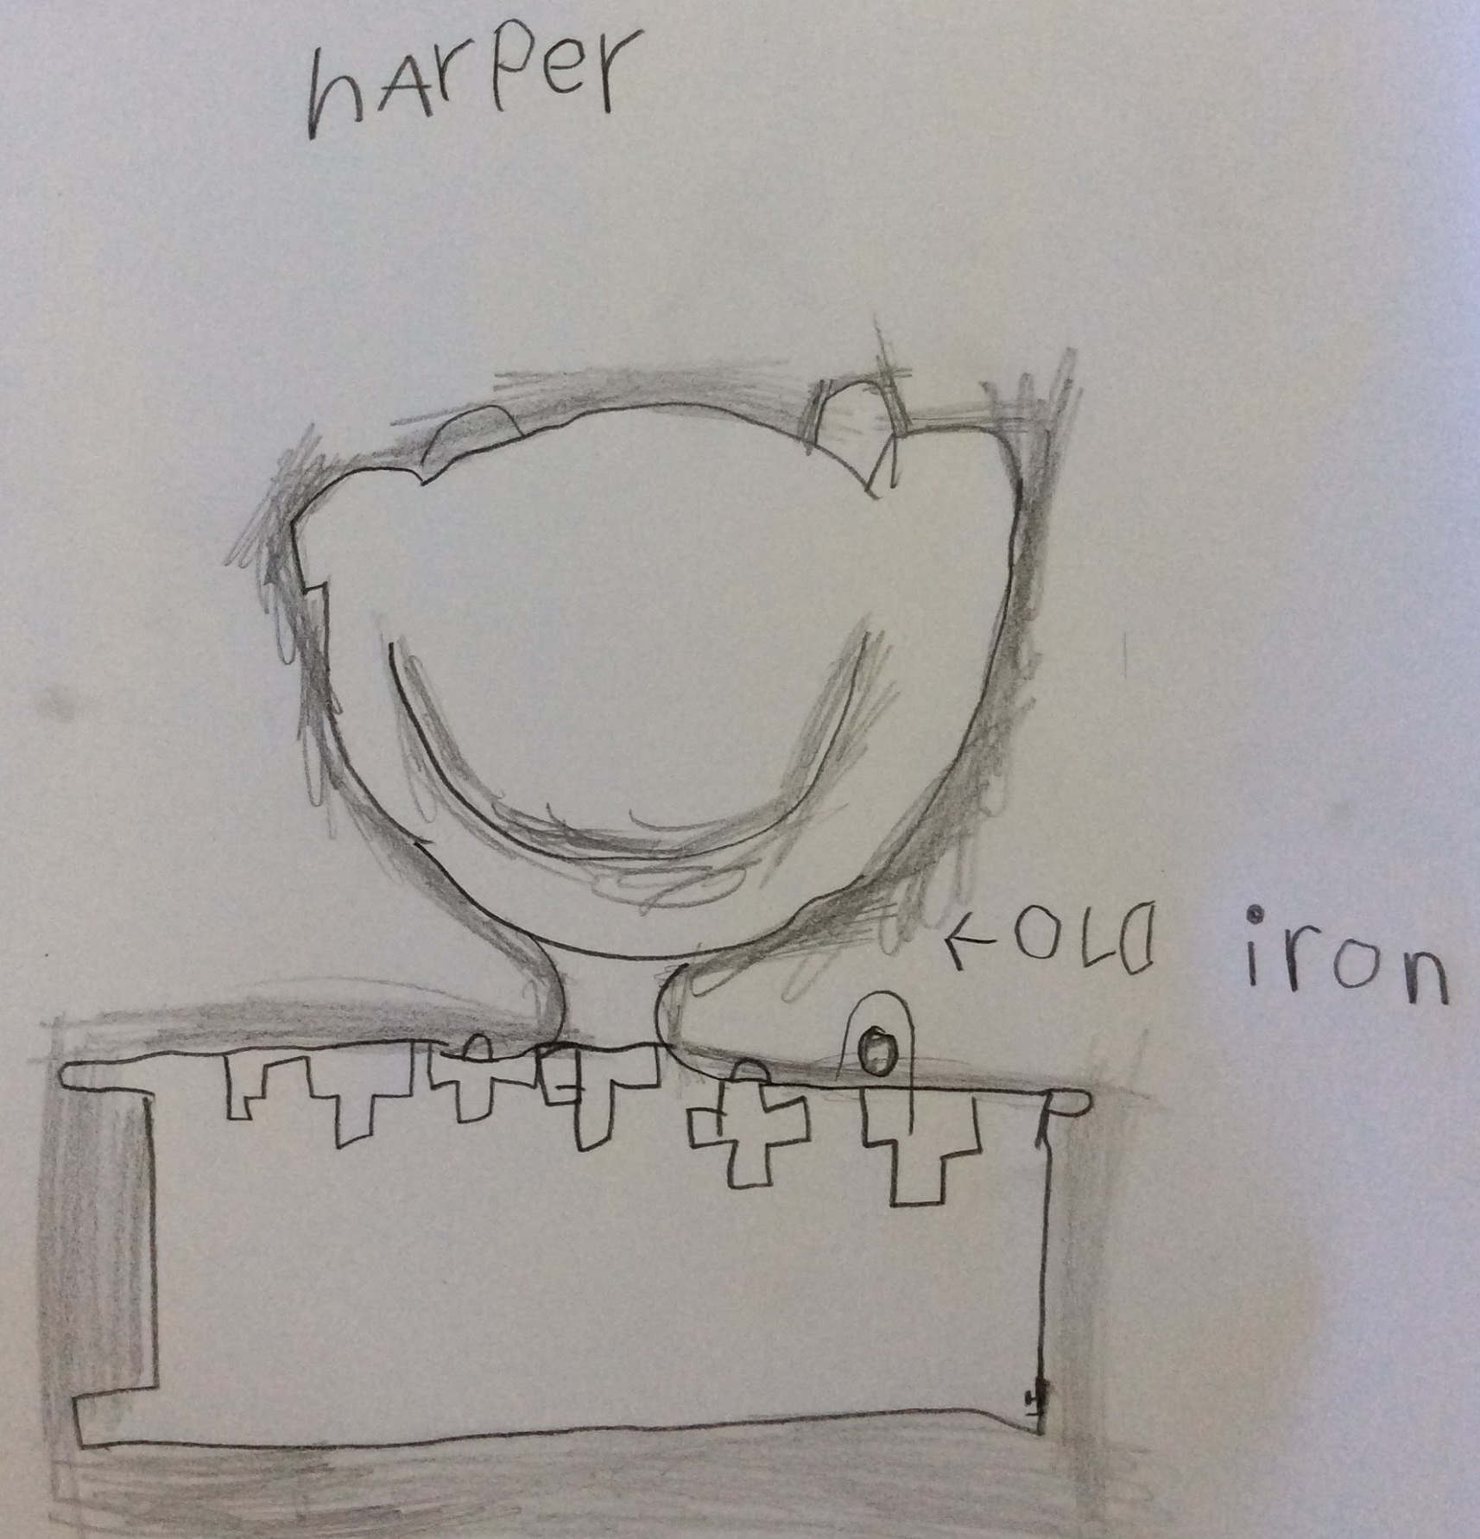
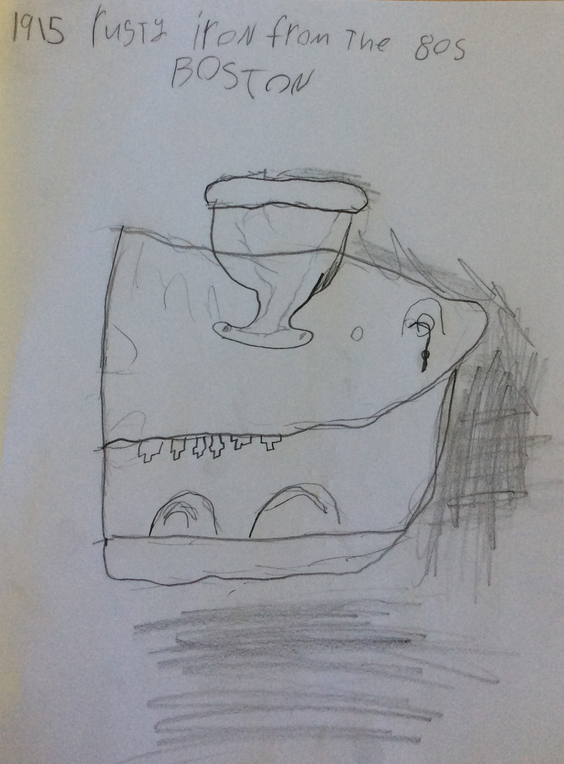

Slide 61
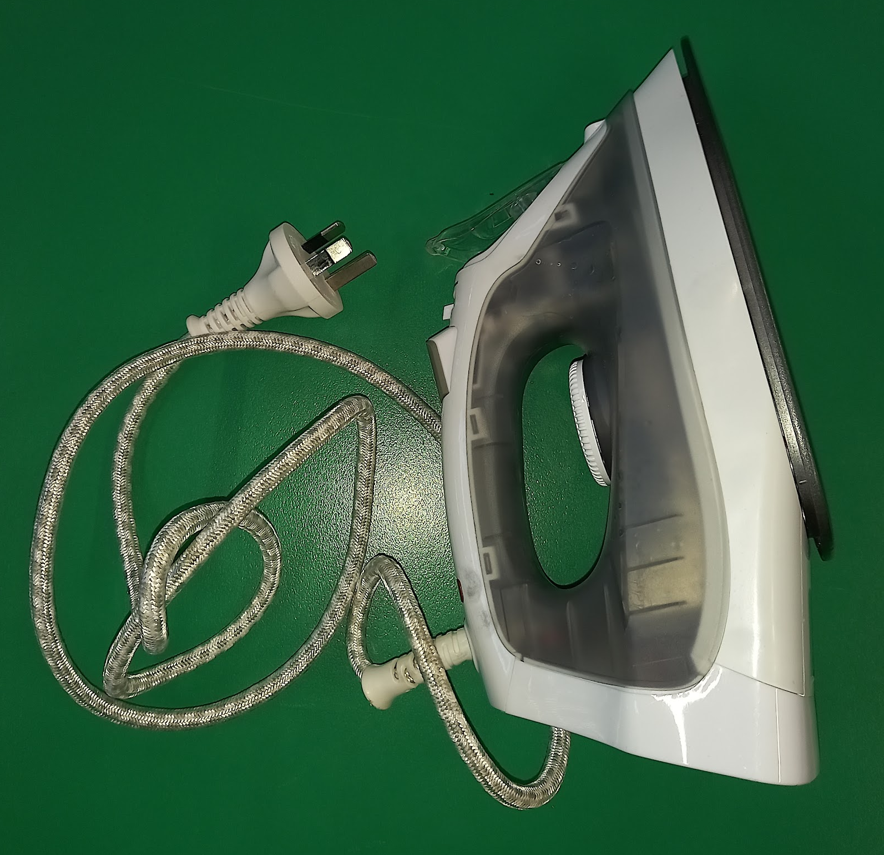
Irons
Now, our irons plug into the power points. A lot of the clothing we wear doesnt need to be ironed.

Slide 62
Heating
Then, many classrooms used to have wood burning fires to keep the children warm. The wood needed to be gathered and split and kept going. It would take a long time to heat a classroom.
Energy before the 20th century
History of Heating
Industrial School, 1874
Notes:
In the late 1800s, immigrant families from Poland, Germany, Italy, Russia, and other countries were vigorously educated in the American cleanliness culture, Suellen Hoy wrote in Chasing Dirt: The American Pursuit of Cleanliness. Children’s fingernails, hair, faces, and teeth were inspected for dirt and they were taught how to “properly” wash up with soap and use toothpicks to scrape the dirt from under their nails. Teachers at overcrowded urban schools also worried about contagious disease and often “quarantined” kids with sniffles and other symptoms. Next, see what women’s workplaces looked like 100 years ago to see just how far we have come.

Slide 63
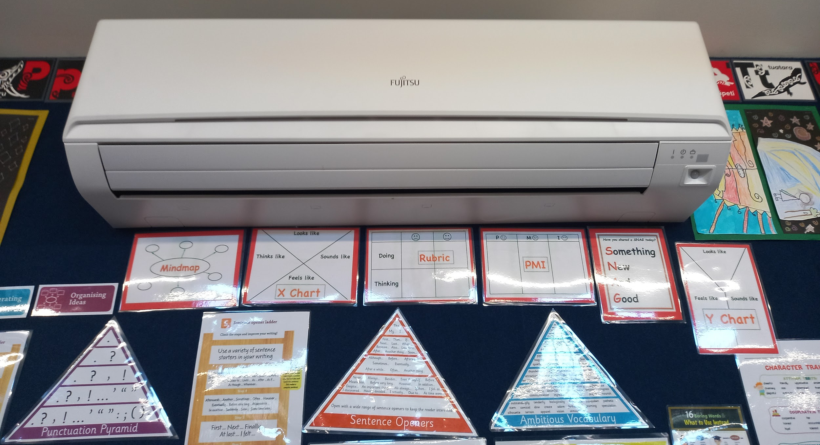
Now, our classrooms have Air Conditioning units that are controlled with remotes.
Notes:
In the late 1800s, immigrant families from Poland, Germany, Italy, Russia, and other countries were vigorously educated in the American cleanliness culture, Suellen Hoy wrote in Chasing Dirt: The American Pursuit of Cleanliness. Children’s fingernails, hair, faces, and teeth were inspected for dirt and they were taught how to “properly” wash up with soap and use toothpicks to scrape the dirt from under their nails. Teachers at overcrowded urban schools also worried about contagious disease and often “quarantined” kids with sniffles and other symptoms. Next, see what women’s workplaces looked like 100 years ago to see just how far we have come.

Slide 64
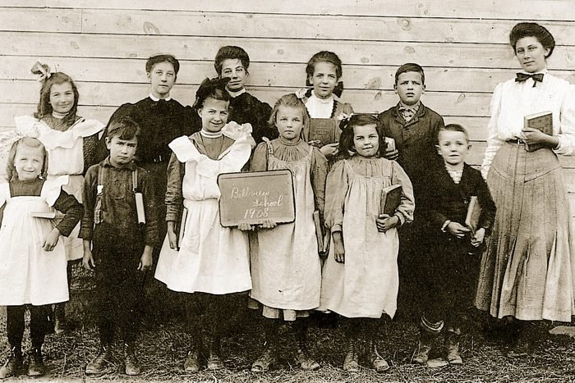
Then, classes could be of all ages.

Slide 65
Now, there are twenty four, seven and eight year olds in our class. We hope you enjoyed our presentation.

Slide 66
HE KARAKIA MUTUNGA
CLOSING FOR THE DAY
E te Papatūānuku,
Kua mutu tātou i te mahi tahi o te rā.
Kia tau tō rangimārie
kei mātou.
Acknowledging the forces of nature (Mother Earth),
We have come to the end of our collaborative work for the day.
May peace be with us all.

